Slide 2
Grab your Bibles!
Our reading for today Luke 1: 26-38
Gospel means “Good News”

Slide 3
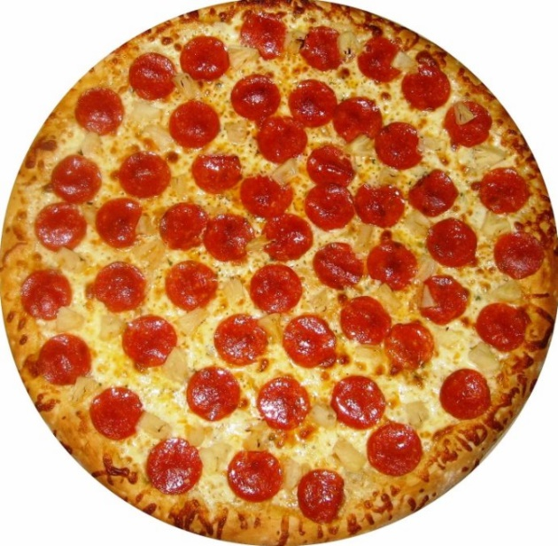
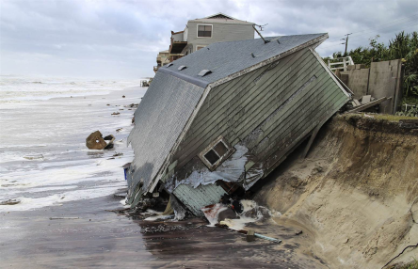
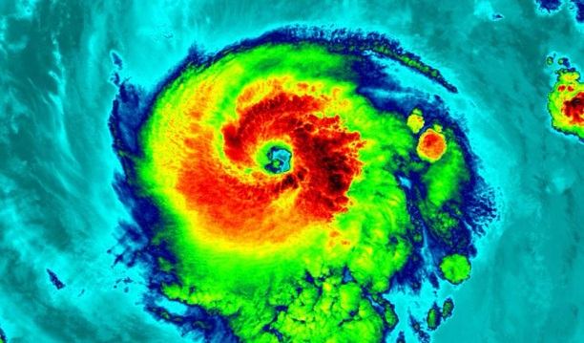
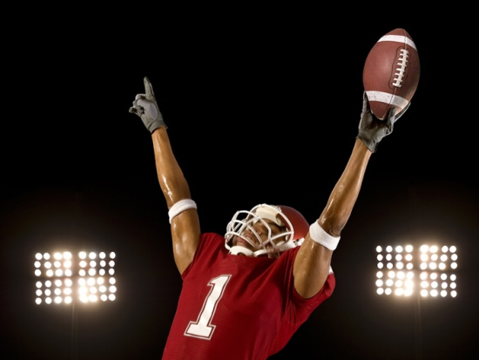
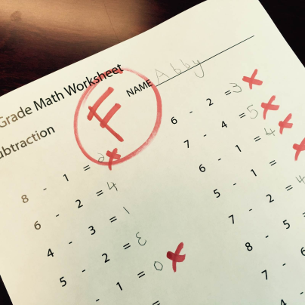
Gospel means “Good News”
Bad News
Good News

Slide 4
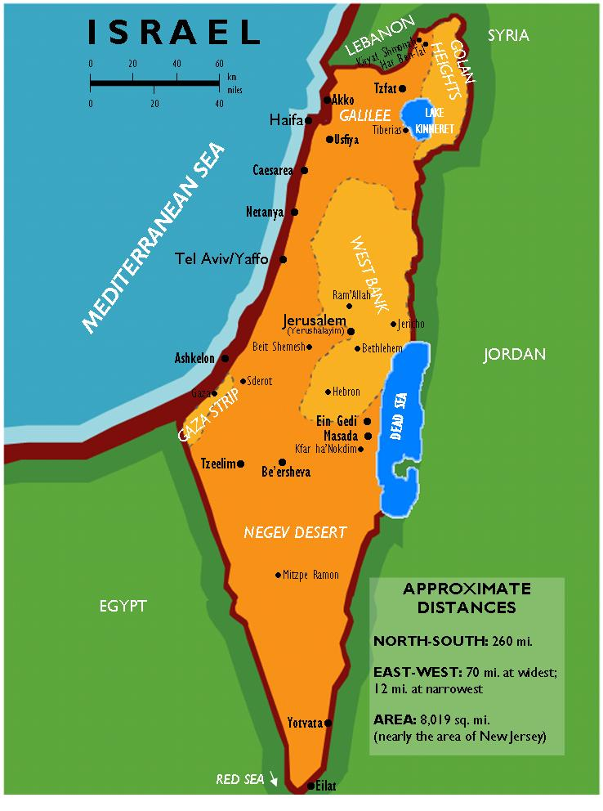
Israel
“Israel” was the people of God
They were the ONLY people of God before Jesus
They had been living in captivity
No choices
No parties
Someone else ruled
400 Years!!

Slide 5
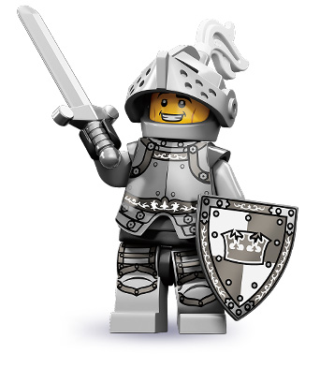
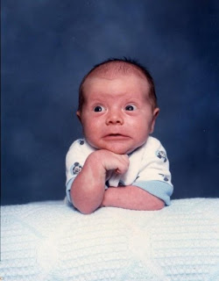
Israel knew God would save them
A king
A warrior
A conqueror
A defender
What they got:

Slide 7
The Annunciation Luke 1: 26-38
“I am the Lord’s servant,” Mary answered. “May your word to me be fulfilled.” Then the angel left her.

Slide 8
What we know…
Mary was young – around 16 years old.
Mary was already engaged to marry Joseph.
Being pregnant before marriage might have meant that she would be an outcast- NO ONE would ever talk to her again!

Slide 9
Mary’s Dilemma
An angel came and talked to her
She was having a baby
She had to tell her family, friends, and fiancé
This baby was the Son of God

Slide 10
Mary’s Response
“I am the Lord’s servant,” Mary answered. “May your word to me be fulfilled.” Then the angel left her.

Slide 11
God Used the Average
God used Mary and an infant Jesus because they were average, every-day, normal.
It was assurance that even we can be used to do God’s work.
God will use us to do great things, we just have to be willing to say yes.

Slide 12
Jesus as a Baby
Jesus came in the form of a little baby to a poor family because he was the God to all people who came not to fight to change the world but to educate, inspire, and transform this world and the people in it.

Slide 13
Our Prayer
In the eyes of the world, the strongest will survive. In the eyes of You, the weakest will survive.
Help us always stand on the side of the meek and humble, as it is among the weak, that we find You.

Slide 14
Small Group Time
How can God use us?
How have you seen God use other people in your life or in the world?

