Slide 2
Let’s Pray

Slide 3
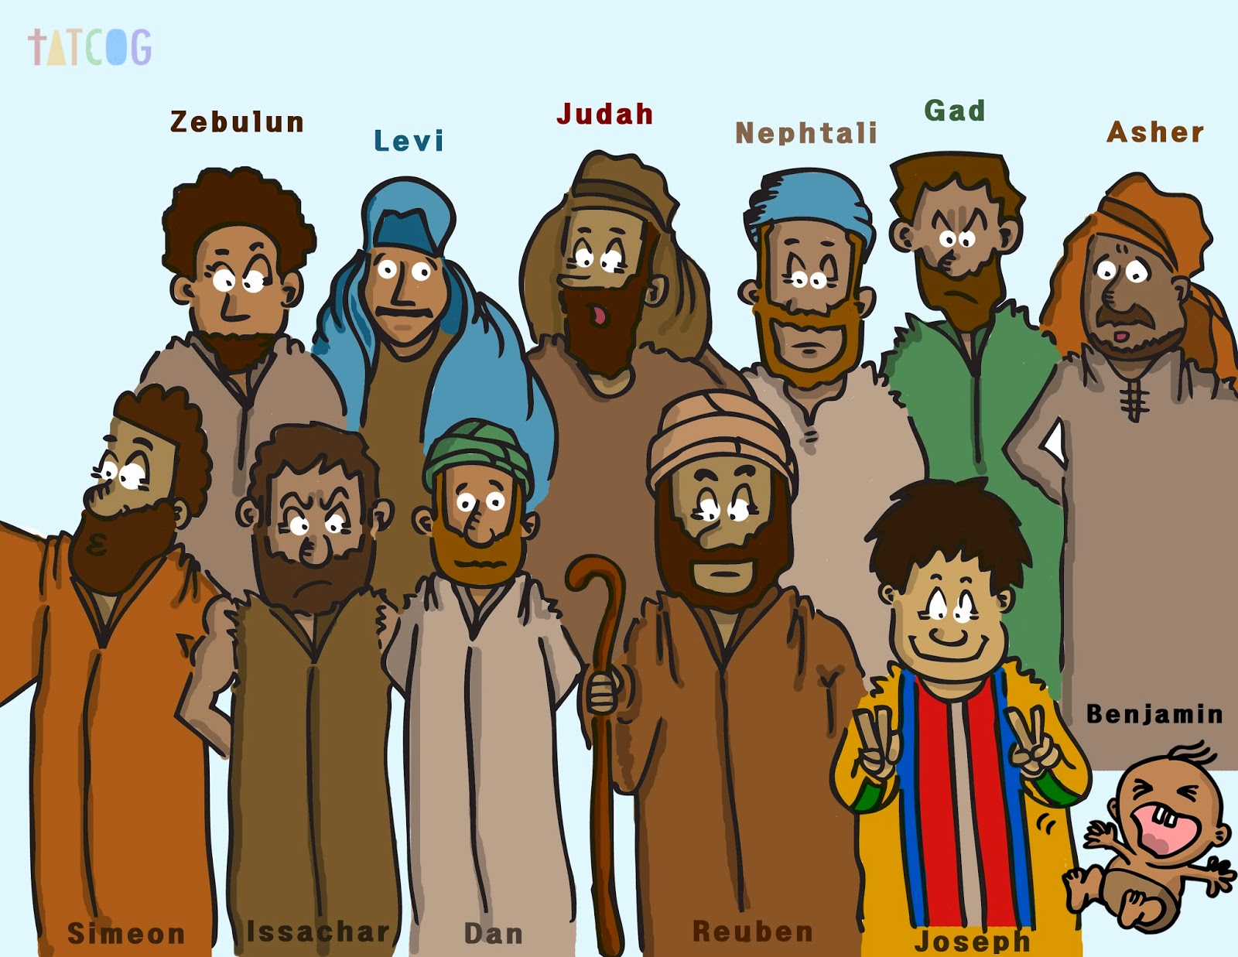
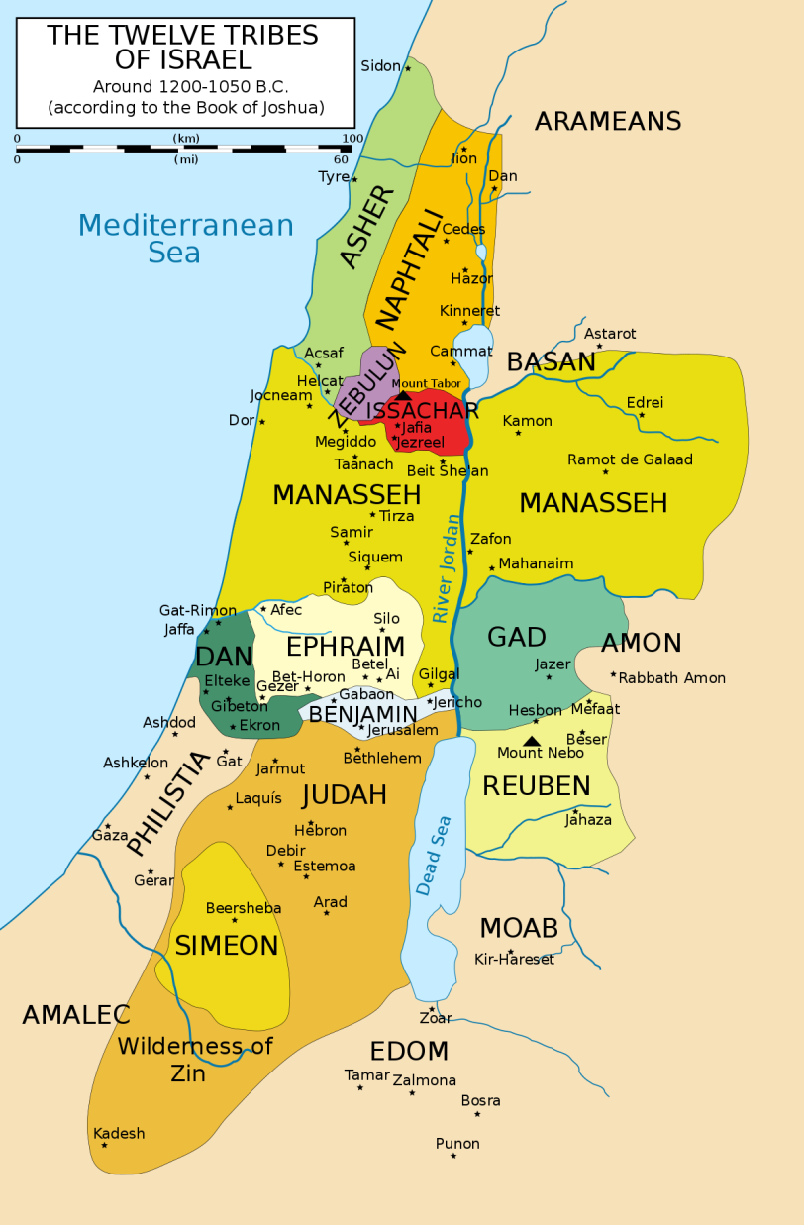
Joseph

Slide 4
Background on Joseph
He was the 11th of 12 brothers
His dad loved him more than all the others
He was spoiled compared to his brothers
One day his brothers threw him into a pit
They decided not to kill him – instead they sold him into slavery
He was purchased by a man named Potiphar, who eventually made him the head of the household
Potiphar’s wife really liked Joseph, but out of respect for God and Potiphar, Joseph ignored her advances
Eventually Potiphar’s wife was so upset that she falsely accused Joseph of assaulting her
Joseph was sent to prison where he met two people who worked for the Pharaoh
He interpreted their dreams and was eventually asked to interpret Pharaoh’s dreams and became in charge of saving Egypt from famine

Slide 6
Bad Things Happen to Good People
List the bad things that happened to Joseph…
He was thrown into a pit and left to die
He was sold into slavery
He was thrown into prison

Slide 7
What came of them…
He was thrown into a pit
His brothers didn’t let him die – he was allowed to live
He was sold into slavery
He became the head of a wealthy man’s household
He was thrown into prison
He interpreted dreams and eventually worked for the Pharaoh

Slide 8
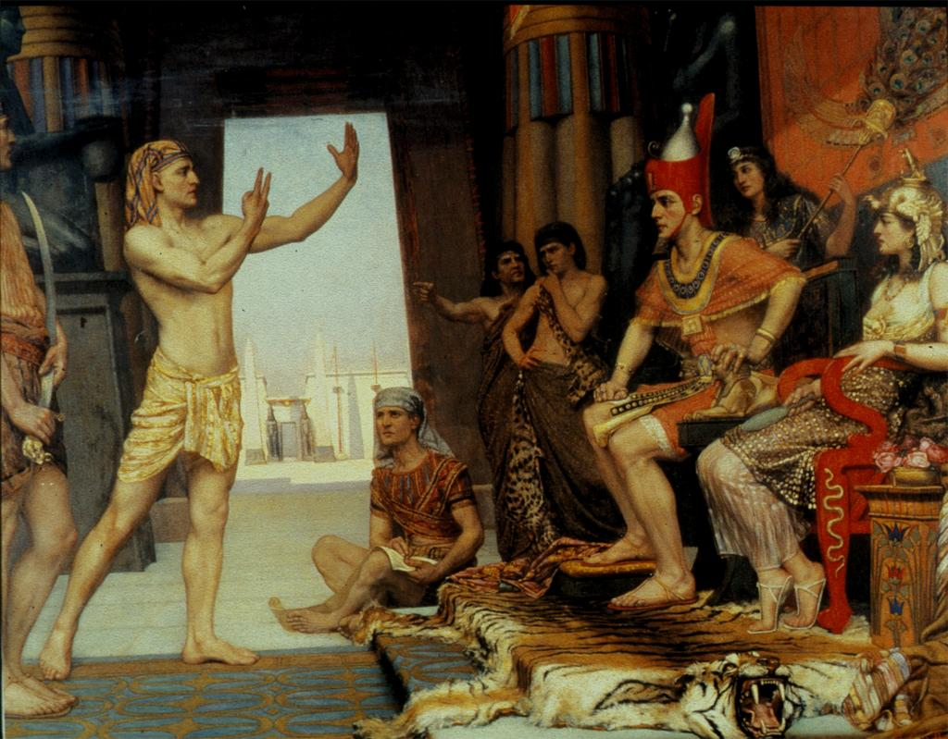
Genesis 41:14-16, 39-40
Giclée Art by Reginald Arthur, 1894.

Slide 10
What do we learn?
We don’t always see the end picture, but God does.
Trusting God does not mean everything will go our way. God can transform any situation. Even the greatest evil can be used for good.

Slide 11
Our Prayer
Lord we know that you are with us even through the hard times. No matter what bad things happen to us, give us faith in you to lead us through.

