Slide 2
Review of last week
•Jesus was blessed – consecrated – as the one, true King.
• The Blessing of Jesus came with consequences and hardship for Mary and Joseph.
• The greatest blessing of this world – Jesus – came with a fair amount of sacrifice and hardship.

Slide 3
scripture
¹³ When they had gone, an angel of the Lord appeared to Joseph in a dream. “Get up,” he said, “take the child and his mother and escape to Egypt. Stay there until I tell you, for Herod is going to search for the child to kill him.”
¹⁴ So he got up, took the child and his mother during the night and left for Egypt, ¹⁵ where he stayed until the death of Herod. And so was fulfilled what the Lord had said through the prophet: “Out of Egypt I called my son.”^{[a]}

Slide 4
scripture
¹⁶ When Herod realized that he had been outwitted by the Magi, he was furious, and he gave orders to kill all the boys in Bethlehem and its vicinity who were two years old and under, in accordance with the time he had learned from the Magi. ¹⁷ Then what was said through the prophet Jeremiah was fulfilled:
¹⁸ “A voice is heard in Ramah, weeping and great mourning, Rachel weeping for her children and refusing to be comforted, because they are no more.”

Slide 5
Blessing
Notes:
Here’s the video

Slide 6
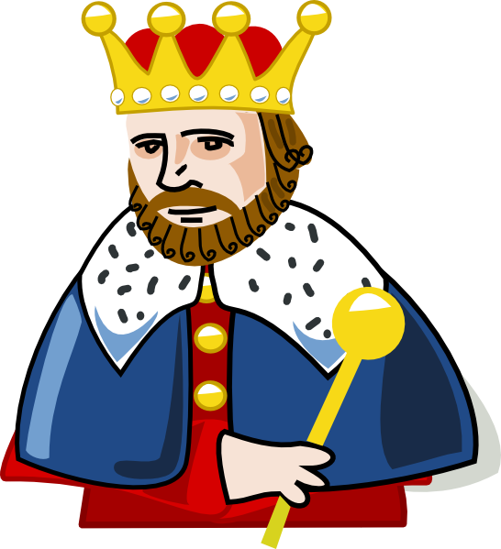
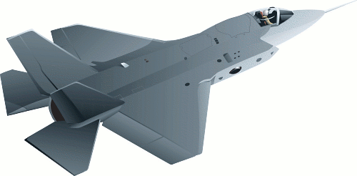
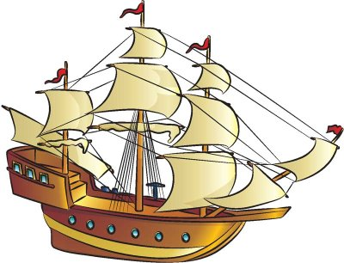
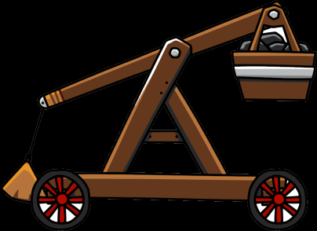
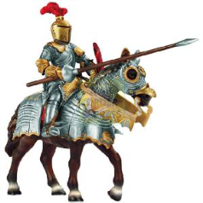
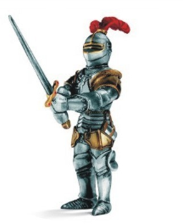
Earthly kingdom

Slide 7
Earthly kingdoms
1) Come from being heard:
* Politicians make grand speeches
* Companies bombard you with commercials
* Herod threatened an entire population

Slide 8
Earthly kingdoms
2) Established by force:
* Countries are created through wars
* Land is bulldozed for cities and towns
* Herod killed thousands

Slide 9
Earthly kingdoms
3) Maintained by power:
* Countries are maintained through laws and regulations
* Companies use money to maintain control
* Herod made decrees and made people fear him

Slide 10
Earthly kingdom

Slide 11
Godly kingdoms
1) Come from listening:
God listens to our prayers and concerns, acting appropriately in response to us.

Slide 12
Godly kingdoms
2) Established by transformation:
God sent Jesus to transform the hearts and minds of us, so that we might be empowered to change the world.

Slide 13
Godly kingdoms
3) Maintained by love:
God’s world is ideally one of love, compassion, and grace. When Jesus came to the earth he loved his enemies, prayed for those that hated him, and died for those that killed him.

Slide 14
Connect with Your Small Group
Blessings and Bummers
Bibles – Matthew 2:13-18

Slide 15
Connect with Jesus (2Q’s)

Slide 16
Jesus was the ultimate Blessing
Think about what “Kingdoms” you belong to in your life: Friend Group
Church Family School Sports Team
Are they Earthly or Godly? Which one is better? Is it wrong to be a part of an earthly Kingdom?

Slide 17
Our Prayer
Dear God, let me be an instrument to your heavenly Kingdom. Help me do the unpopular thing when I know it’s for you. Use me to bring your Kingdom of Heaven here to earth. In your name we pray.
Amen

Slide 18
Blessing
The Lord bless you and keep you; the Lord make his face shine on you and be gracious to you; the Lord look upon you and give you peace.

