Slide 2
Let’s Pray

Slide 3
Recap
Creation
Garden- Fall & Suffering
Flood
Abraham and Sarah– God’s First Covenant
Jacob and Esau
Jacob-> Israel
12 Sons
Joseph -> to Egypt
Moses
Exodus
10 Commandments
Promised Land
Judges
David

Slide 4
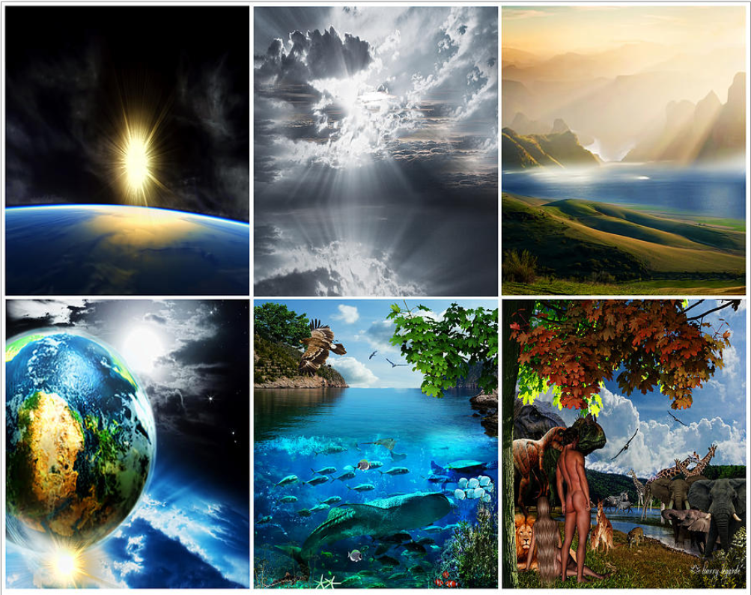
Light
Water and Sky
Land with Plants
Day and Night
Fish and Birds
Mankind & Beasts

Slide 5
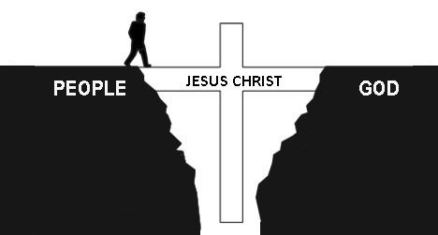
¹⁵ I will cause hostility between you and the woman, between your offspring and her offspring. He will strike your head, you will strike His heel.

Slide 6
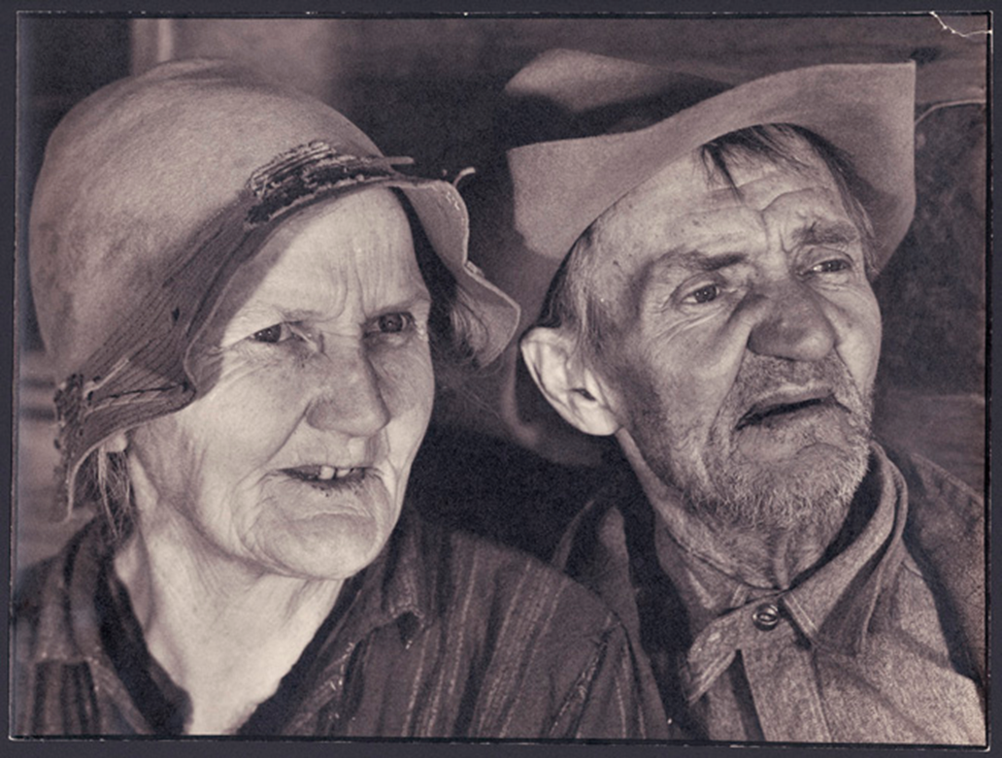
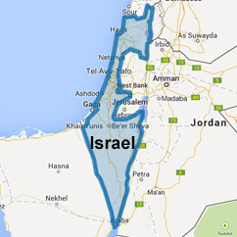
A New Nation!
The Promise:
God
Land
Kids
Sarah
Abraham
Isaac
Notes:
God’s covenant- “I will be their God, they will be my people!”

Slide 7
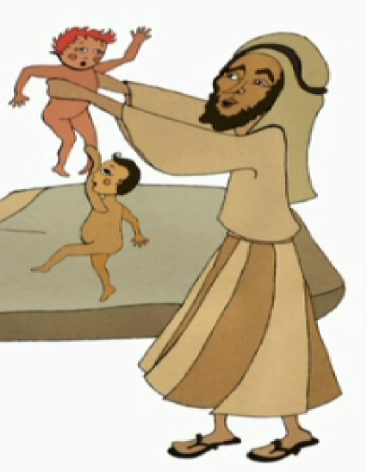
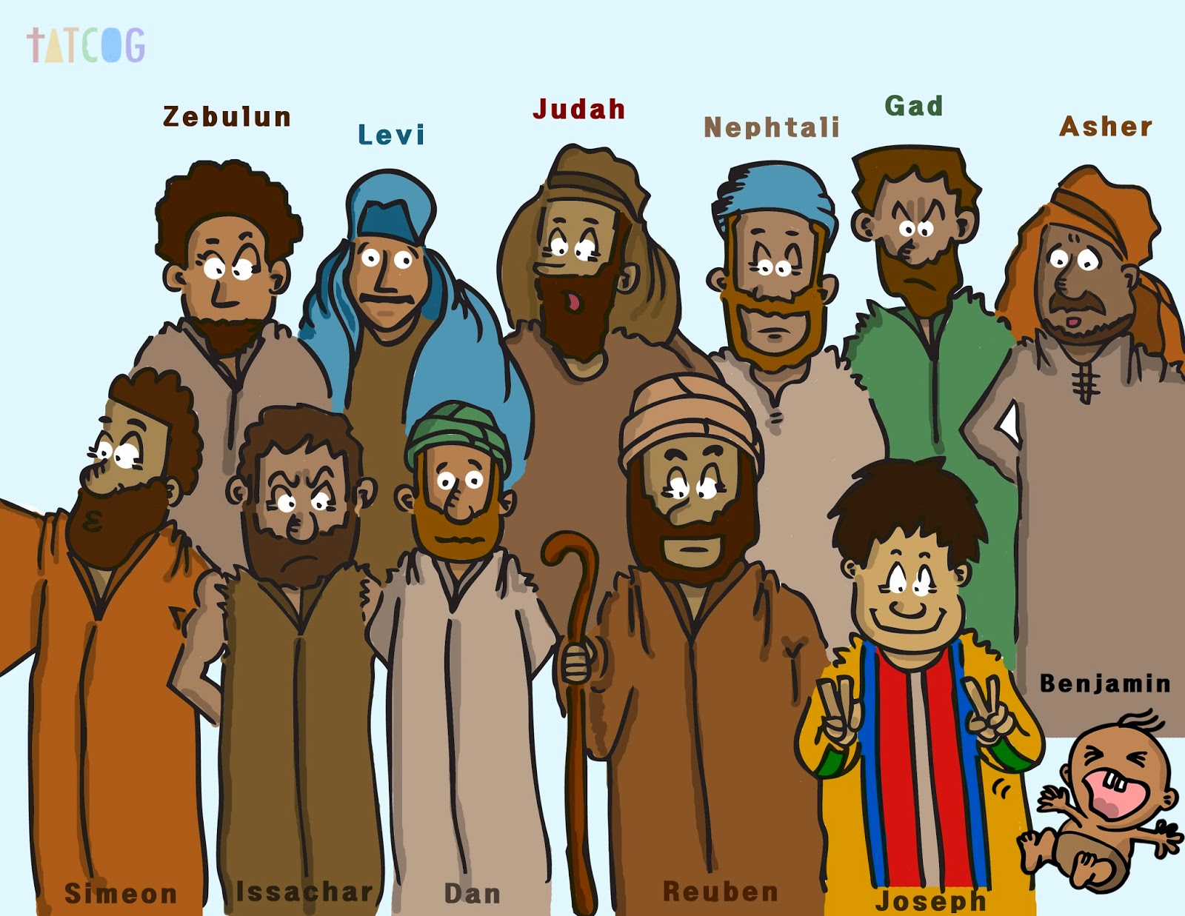

Slide 8
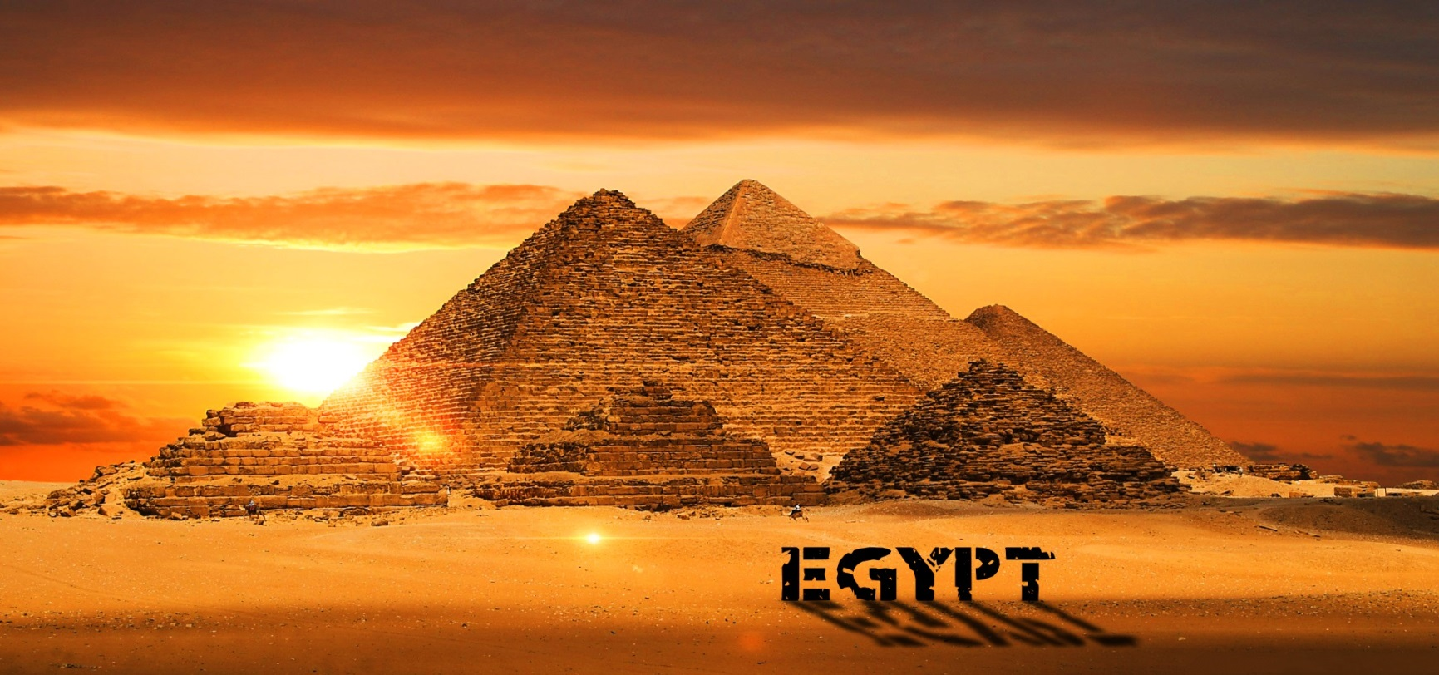
²⁰ You intended to harm me, but God intended it for good to accomplish what is now being done, the saving of many lives.

Slide 9
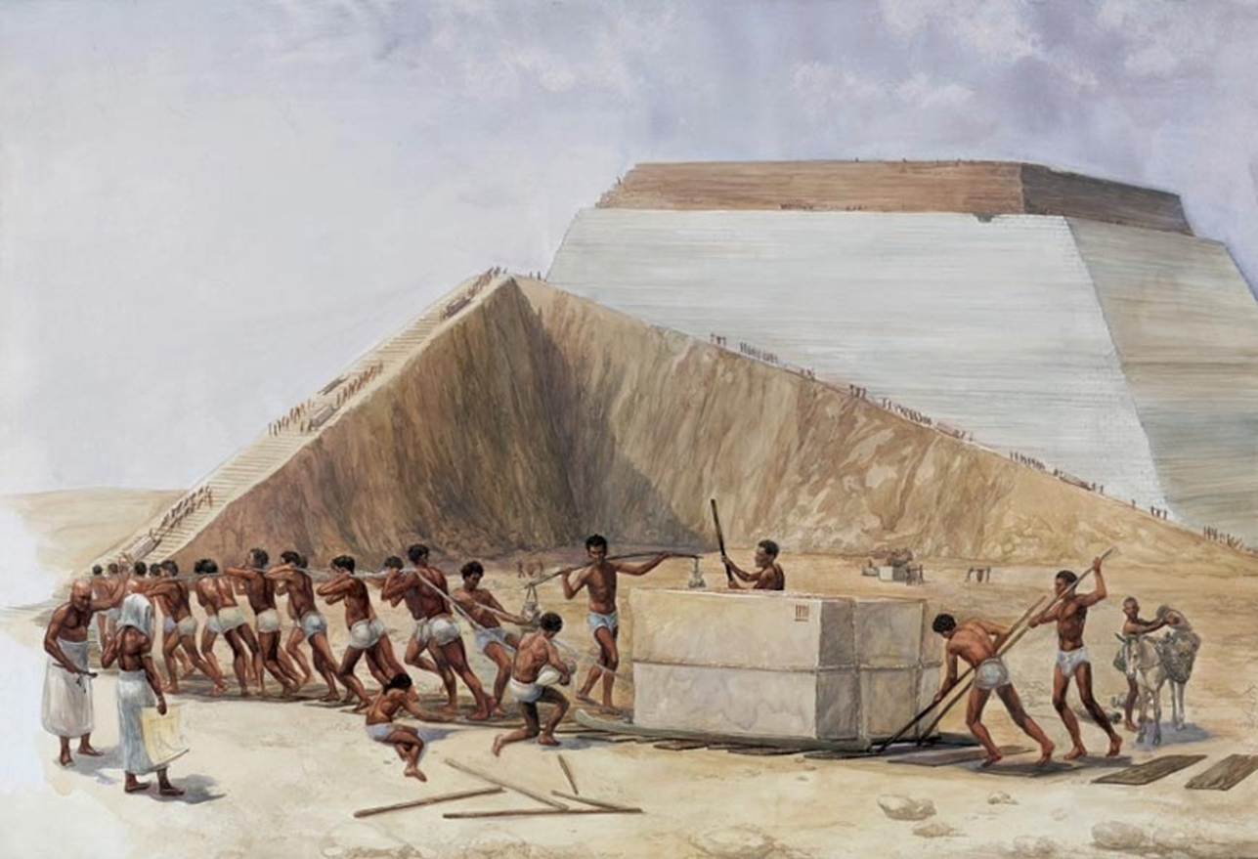
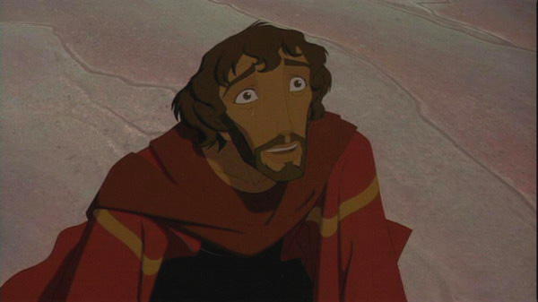
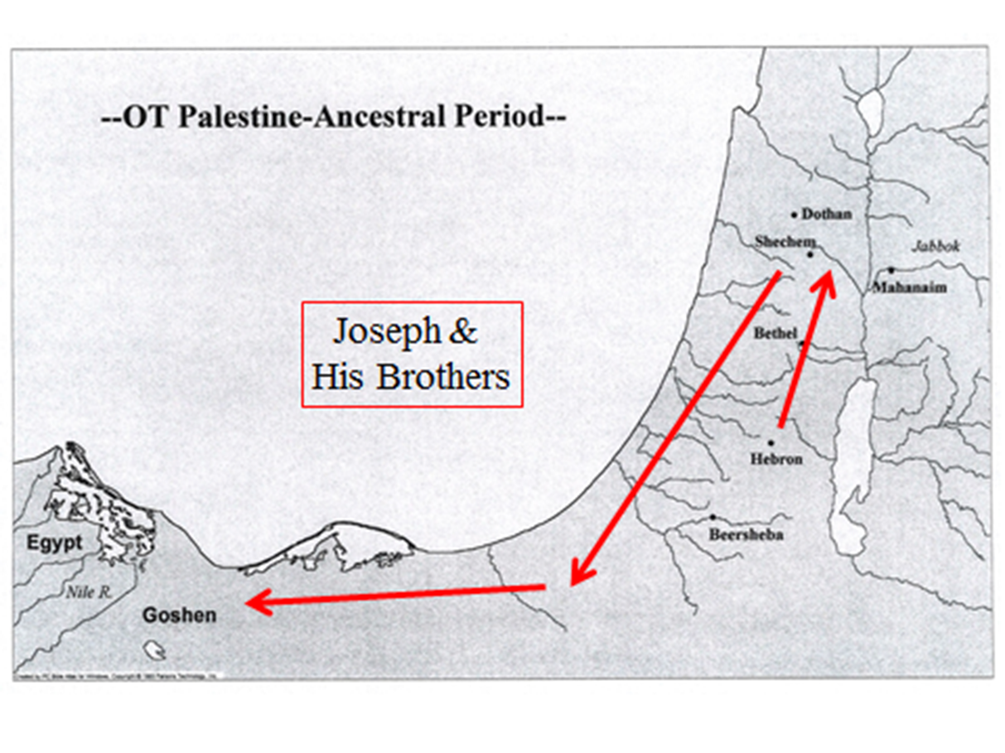
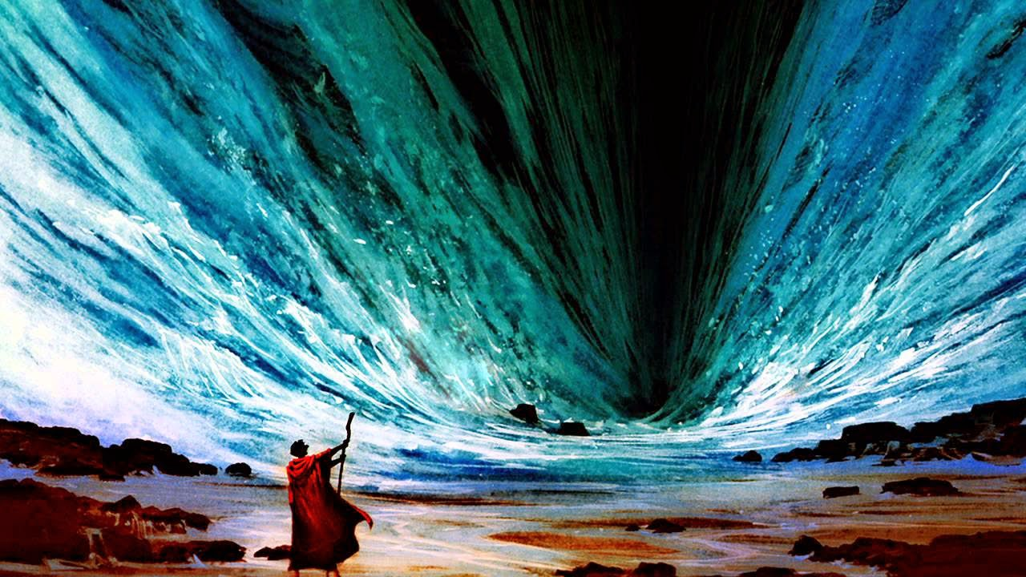

Slide 10
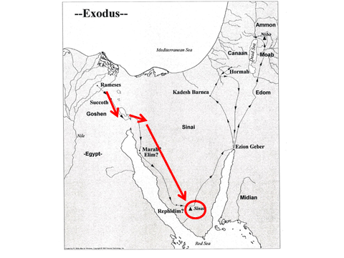
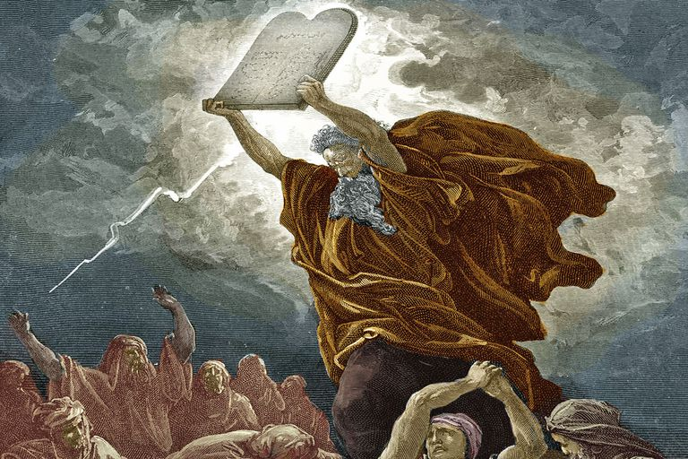

Slide 11
Egypt

Slide 12
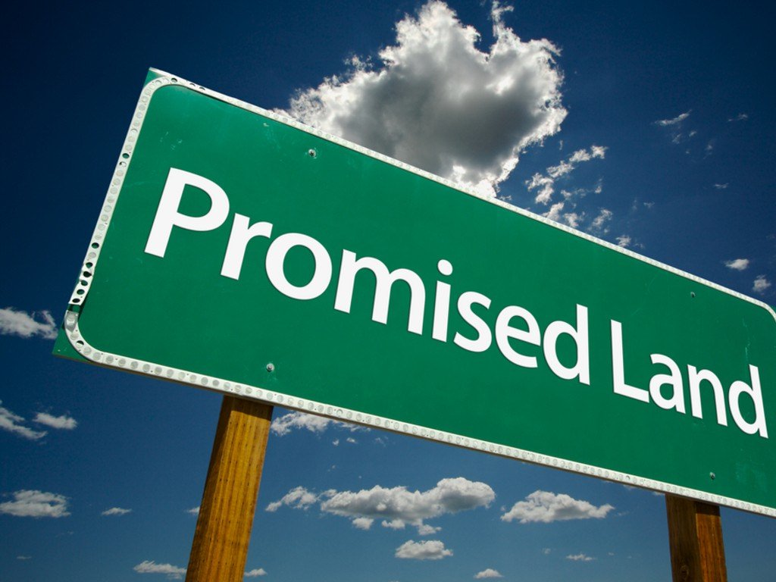
Promised Land

Slide 13
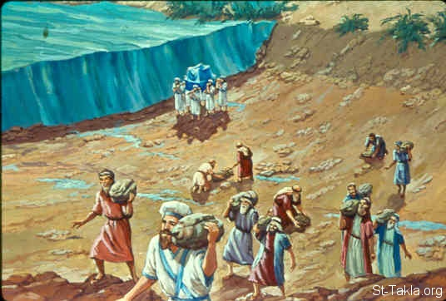
Joshua 3:5-17,4:18

Slide 14
ISRAEL TURNS ITS BACK ON GOD
OPPRESSED BY OTHER NATIONS
JUDGES
GOD RESCUES THEM
HELP!
HELP!
WE’RE SORRY GOD!

Slide 15
Kings of God’s People
Saul
David
Solomon
Israel splits into two

Slide 16
King David
Youngest and smallest of 7 sons
Israel’s most important King
David was righteous- meaning God was always first for him

Slide 18
Kings of God’s People
Saul
David
Solomon
Israel splits into two Israel (North) and Judah (South)

Slide 19
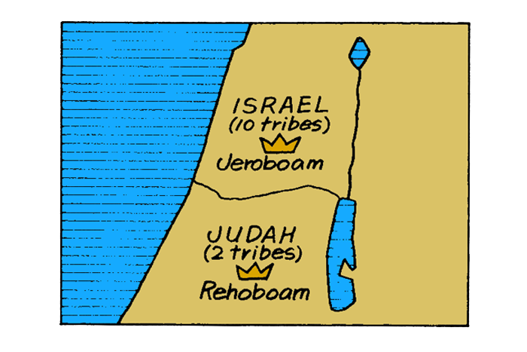
JERUSALEM

Slide 20
Fun Facts
The kingdoms lasted 500 years and ended about 500 years before Jesus.
Israel (North) falls to Assyria in 703BC
Judah (South) falls in 586BC to Babylonia
Israel (North) becomes “Samaria” in Jesus’ time

Slide 21
More Fun Facts
There were around 40 kings during this time between the two kingdoms.
Report Card:
6 were “good”
- turned their heart towards God

Slide 22
God, please help us to turn our hearts toward you every day and show us the best choices to make.
Amen.

