Slide 2
Would you Rather?

Slide 3
Would you rather?
GO SKYDIVING?
GO BUNGEE JUMPING?

Slide 4
Would you rather?
HAVE CHICKENS FOR HANDS?
HAVE DUCKS FOR FEET?

Slide 5
Would you rather?
BE MOURNING?
BE JOYFUL?

Slide 6
Would you rather?
ALWAYS HAVE COLD FEET?
ALWAYS HAVE SWEATY HANDS?

Slide 7
Would you rather?
EAT ONLY ORANGES FOR THE REST OF YOUR LIFE?
LOSE SENSE OF SMELL FOR THE REST OF YOUR LIFE?

Slide 8
Would you rather?
BE RICH?
BE POOR?

Slide 9
Would you rather?
ALWAYS WEAR SUNGLASSES?
ALWAYS HAVE SOMETHING IN YOUR EYE?

Slide 10
Would you rather?
BUILD YOUR HOUSE ON SAND?
BUILD YOUR HOUSE ON ROCK?

Slide 11
Would you rather?
WIN A MILLION DOLLARS?
HAVE A LIFETIME SUPPLY OF ANY ONE ITEM?

Slide 12
Would you rather?
MEMORIZE SOMETHING?
LEARN SOMETHING?

Slide 13
Jesus - Teaching
When Jesus preached, he asked people not just believe, but to do!

Slide 15
Matthew 7:24-27
²⁴ “Everyone then who hears these words of mine and acts on them will be like a wise man who built his house on rock. ²⁵ The rain fell, the floods came, and the winds blew and beat on that house, but it did not fall, because it had been founded on rock. ²⁶ And everyone who hears these words of mine and does not act on them will be like a foolish man who built his house on sand. ²⁷ The rain fell, and the floods came, and the winds blew and beat against that house, and it fell—and great was its fall!”

Slide 16
When we act on Jesus’ teachings, we build a foundation that we can stand on when the storms of life come.
We hear Jesus’ teachings every week but there’s a difference between knowing the lessons and living the lessons.

Slide 17
A Short Story about Birds
Oliver Miller

Slide 20
We are birds, and birds have wings!

Slide 21
We are birds, and birds can fly!

Slide 22
We are birds, we are birds, and birds are creatures of the air; the lovely air! Always remember this, for we are birds!

Slide 23
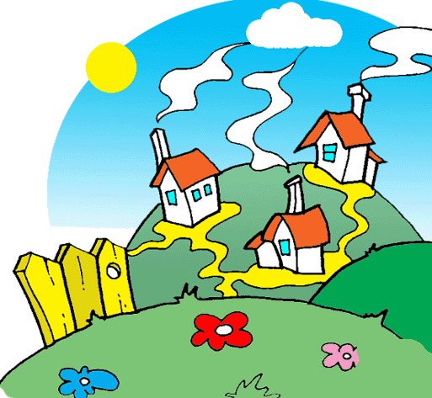

Slide 24
Strange
Must not be from around here
Hmm...

Slide 26
Short Story about Birds
For after all, what would you suggest – or would you have been the one to do anything differently?

Slide 27
Connect with Your Small Group
Offering
Blessings and Bummers
Bibles – Matthew 7:24-29

Slide 28
Connect with Jesus (2Q’s)

Slide 29
Chinese Proverb
I hear and I forget, I see and I remember, I do and I understand.

Slide 30
Christian Faith
Our Christian faith is about living out Jesus teachings – not just knowing them. Much like school when you prepare for a test you can either memorize facts and soon forget them or you can learn facts and use them for your lifetime.

Slide 31
Our Prayer
Thank you God for your Son and his teachings. Let us take what we learn and use it to shine light in all the dark places of this world.
Amen.

Slide 32
Blessing
The Lord bless you and keep you; the Lord make his face shine on you and be gracious to you; the Lord look upon you and give you peace.

