Slide 2
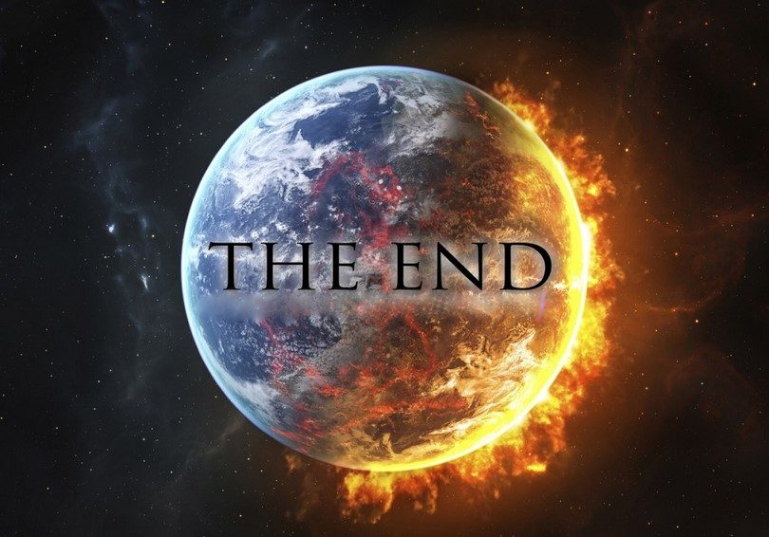

Slide 3
Disciple John wrote
Describe Jesus’ Life
Paul Wrote

Slide 4
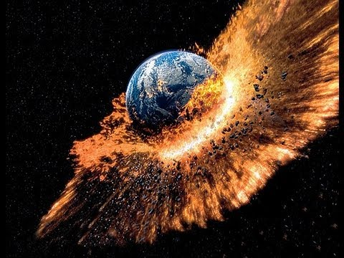
Will the world end?

Slide 5
According to Revelation:
Yes. And it describes how. Kind of.

Slide 6
Here’s what you should know:
This book is not straightforward.
There are no times or dates mentioned.
There are LOTS of images
Some are good, some are scary, many seem impossible
Just like with the story of creation, we don’t know if it is exactly as described

Slide 7
What we know for sure
Jesus will come back
The world will end
Sin- pain, tears, death, the devil, brokenness- will all go away
We’ll have a new earth and live forever with God
God is pictured as AWESOME!

Slide 8
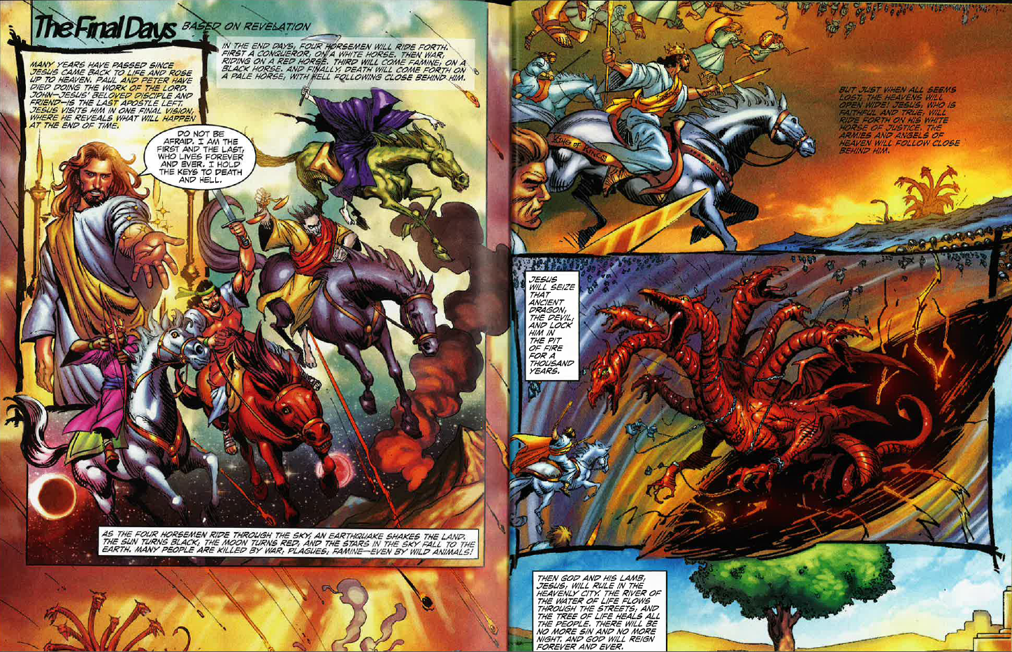

Slide 9
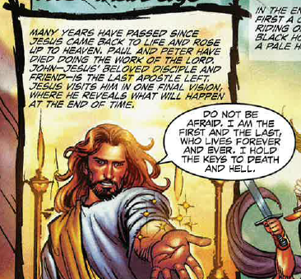

Slide 10
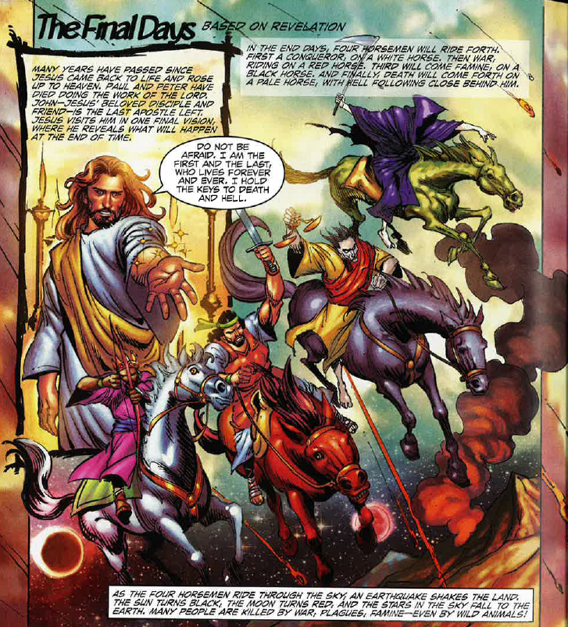

Slide 11
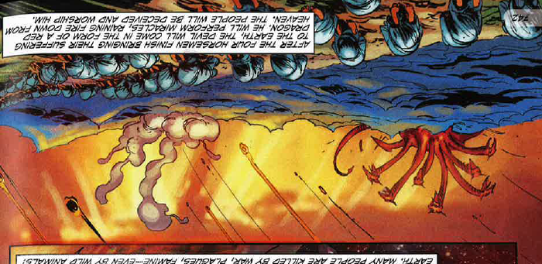

Slide 12
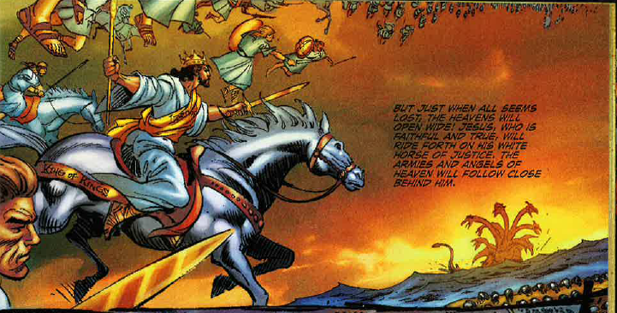

Slide 13
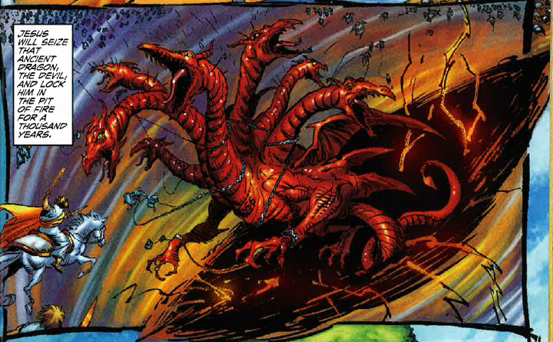

Slide 14
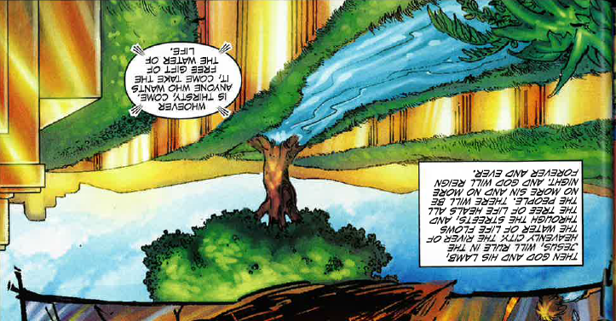

Slide 16
What happens to bad people after life?
There are “good people” who don’t believe in God? What will happen to them?

Slide 17
It’s not about Good and Bad.
It’s about perfect.
The only one who is perfect is Jesus, so Jesus gets to choose what happens after death.
The question isn’t: “were you good or were you bad?” The question is: “are you God’s?”

Slide 18
Chalk Challenge
Get in groups of 2-3.
Each group will have one image to create.
You will have 10 minutes to complete your drawing with as many details as possible.
At the end of 10 minutes, each group will present their drawing to the class.
Please share chalk!

