Slide 2
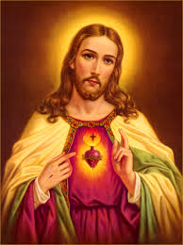
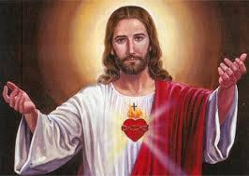
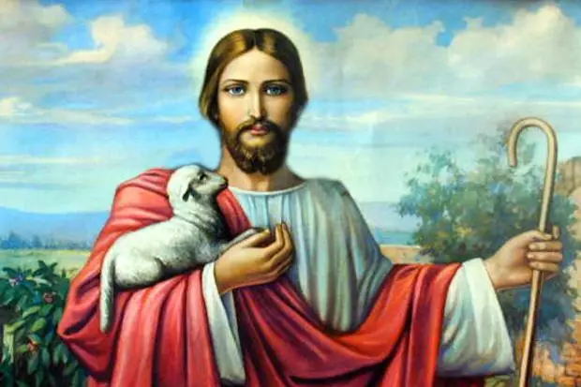
Jesus Christ
Do you feel like you really know who Jesus is?

Slide 3
Fun Facts
Jesus was a real person: four different sources (other than the Bible) confirm this
Jesus probably didn’t look like this

Slide 4
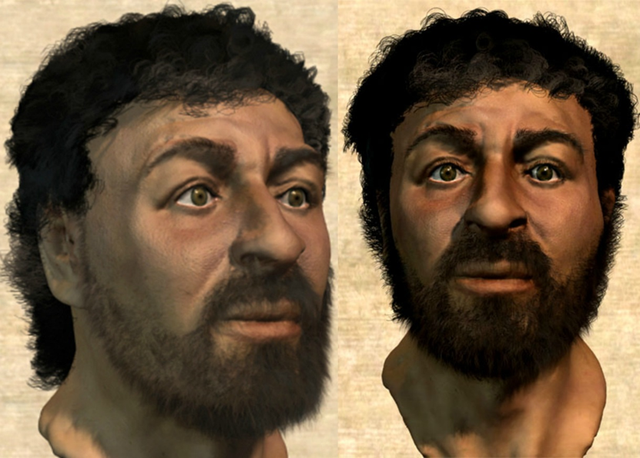
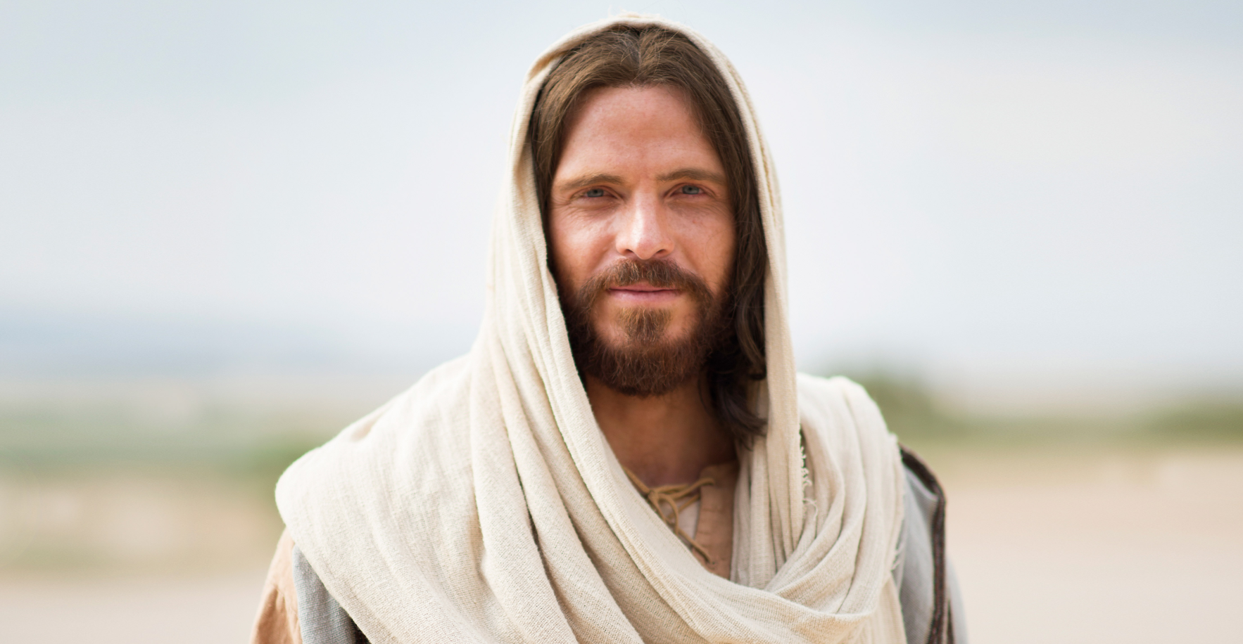

Slide 5
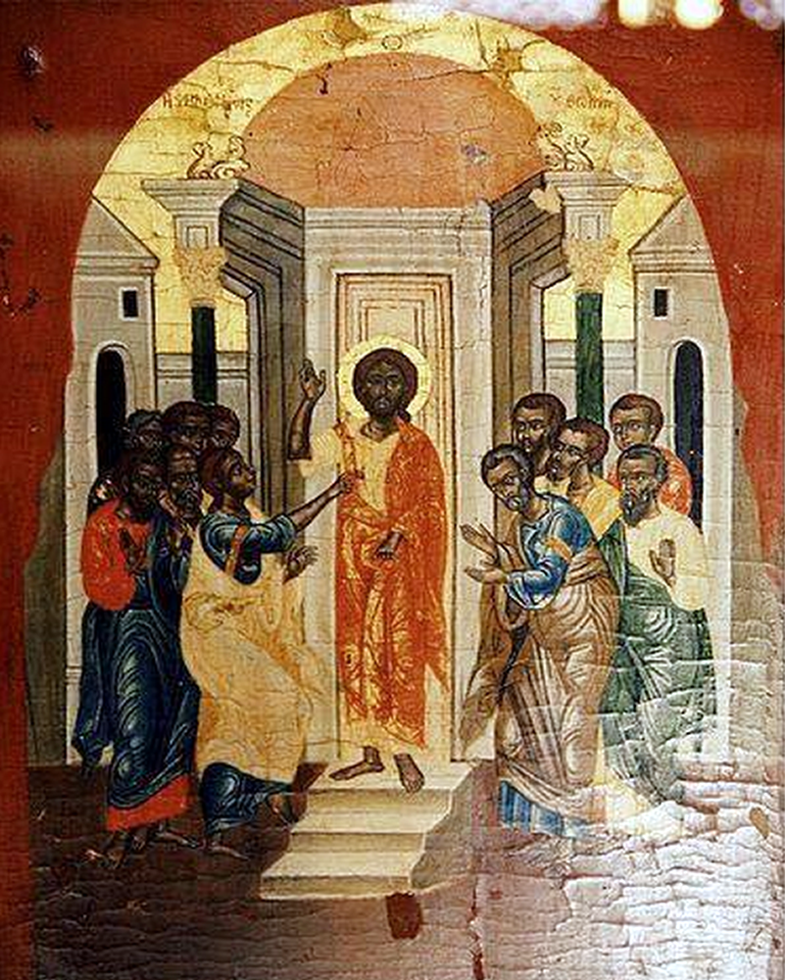
Oldest Jesus
Found in Syria
Dates to 235

Slide 6
Jesus was known for:
Teaching
Doing miracles
Telling stories (parables)
Having compassion
Having followers (disciples)
Dying
Not staying dead!
Changing all the rules

Slide 7
What are some of your favorite stories?

Slide 8
Stories with Meaning
Aesop’s Fables
The Boy Who Cried Wolf
Hansel and Gretel
The Tortoise and the Hare
Think “moral of the story”

Slide 9
Jesus’ Parables
Jesus spoke in simple stories that were
Easy to remember
Easy to understand
Confusing to the bad guys

Slide 11
Jesus told us parables to help us understand…
The Kingdom of Heaven is like….
A mustard seed (Mark 4:30-32)
Yeast in bread (Matt. 13:33)
A treasure in the field (Matt. 13:34)
A pearl of great price (Matt. 13:45)

Slide 12
Jesus told us parables to help us understand…
God’s extraordinary forgiveness and grace
Workers in the vineyard (Matt. 20:1-16)
The unforgiving slave (Matt. 18:21-35)
God’s extraordinary love for the lost
The lost sheep and coin (Luke 15:3-7)
The prodigal son (Luke 15:11-32)

Slide 13
Jesus told us parables to help us understand…
How we should treat one another
The rich man and Lazarus (Luke 16: 19-31)
The good Samaritan (Luke 10: 25-37)
How to be wise
The ten maidens (Matt 25: 1-10)
Building a tower (Luke 14:25-35)

Slide 14
Our Prayer
Thank you for your stories that light our way and help us understand your kingdom.
Amen.

