Slide 2
God’s Big Story
The Body of Christ

Slide 3
Describe Jesus’ Life
Paul Wrote

Slide 4
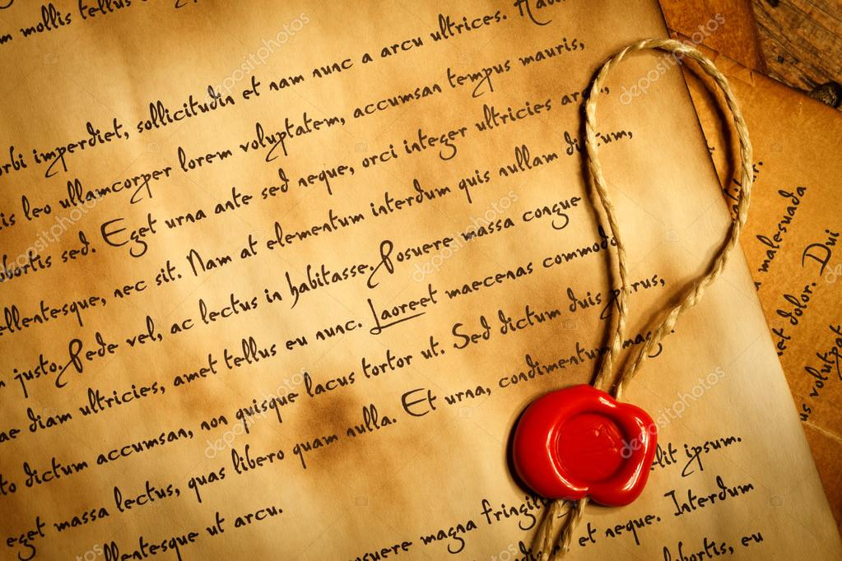
Paul started a lot of churches in the Mediterranean. After they were started, we would write them letters so they would know how to best be Christians and follow Jesus.
Let’s look at his first letter to Corinth.

Slide 5
Grab a Bible- Let’s Read
1 Corinthians 12:12-26
“All of you together are Christ’s body, and each of you is part of it.”

Slide 7
Game Time!

Slide 8
Discussion
Why do you think the Apostle Paul chose to compare the church to a body?
What does this tell us the church should be like?
“But our bodies have many parts, and God has put each part just where he wants it” (v18) What do you think you can do to play your part in the body?

Slide 9
What are you good at?
A worksheet might help.

Slide 10
Prayer
God, thanks for including each of us in the body of Christ.
Thanks for the gifts of each of us here today.
Help us to understand our gifts and show us how to use them in your church.
In Jesus’ name we pray,
Amen.

