Slide 2
https://www.youtube.com/watch?v=maT4phfTXR4

Slide 4
Today: Baptism
Water carries a lot of symbolism. It cleans and washes. It moves and takes many shapes. It is powerful and nourishing. It marks us as God’s children in baptism. Water is necessary for our physical life, just as Jesus is necessary for spiritual life. Through Jesus, we can be filled with God’s love.

Slide 5
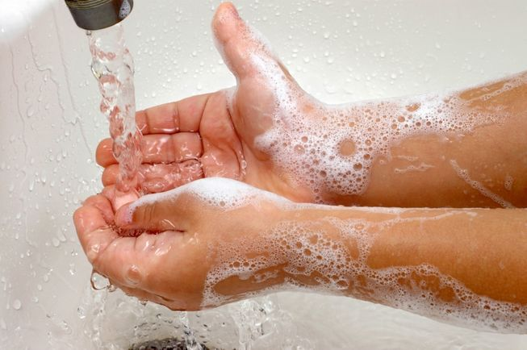
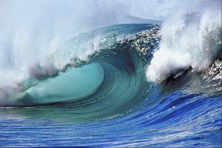
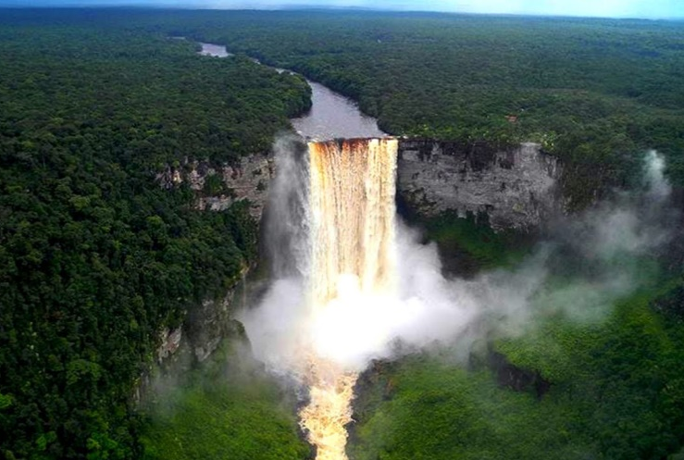
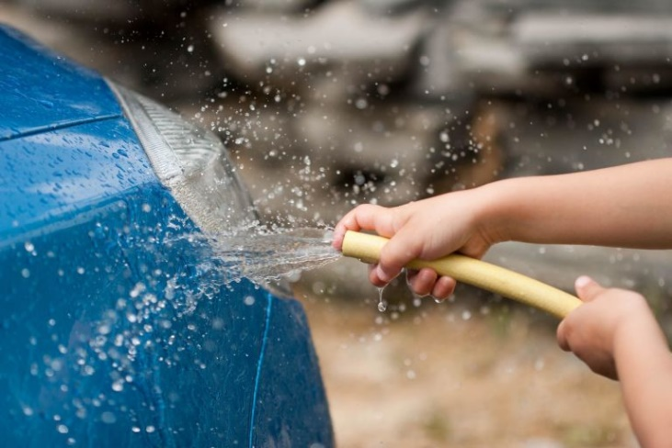
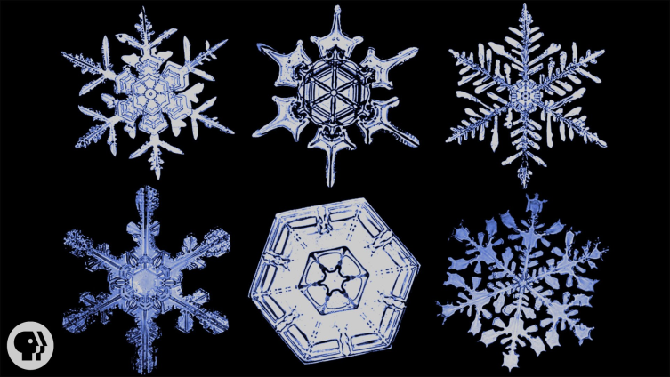
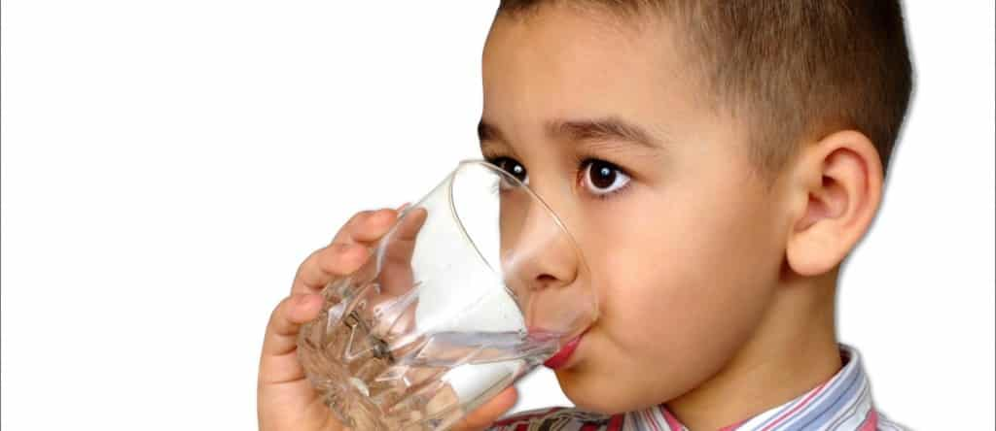
Water helps describe what Jesus does for us.

Slide 6
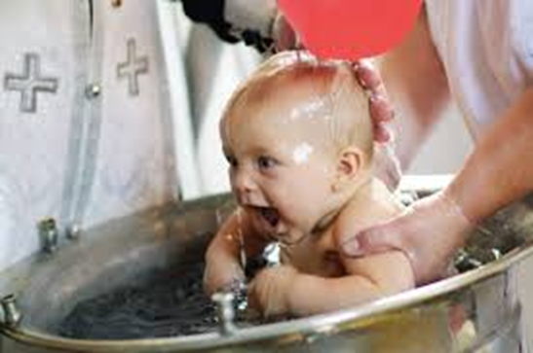
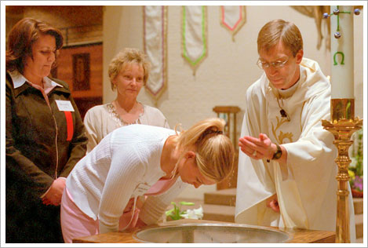
Baptism
Isn’t just a one time thing: it’s daily.
The first time can happen at any age.

Slide 7
baptism
Not everyone has been baptized.
Baptism is a sacrament, which means it is VERY important and VERY holy. It is holy because it is something Christ asks us to do.
“Therefore go and make disciples of all nations, baptizing them in the name of the Father and of the Son and of the Holy Spirit, and teaching them to obey everything I have commanded you. And surely I am with you always, to the very end of the age.”
^{-Matthew 28:19-20}

Slide 8
So, why do it?
Jesus asked us to!
But, what does it mean?
It means our journey with God starts here.
We usually baptize babies because they didn’t DO anything to earn God’s love. Neither do we.

Slide 9
Scripture: Mark 1:9-11
The Baptism of Jesus
⁹ At that time Jesus came from Nazareth in Galilee and was baptized by John in the Jordan. ¹⁰ Just as Jesus was coming up out of the water, he saw heaven being torn open and the Spirit descending on him like a dove. ¹¹ And a voice came from heaven: “You are my Son, whom I love; with you I am well pleased.”

Slide 10
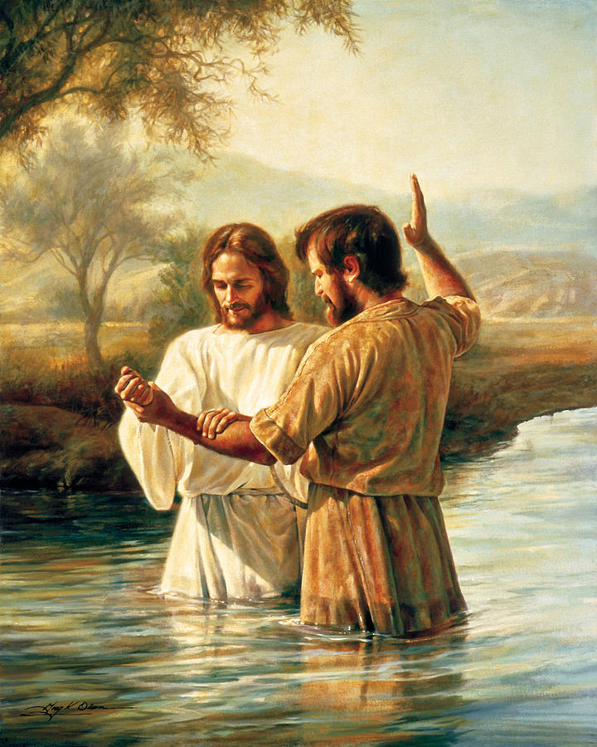
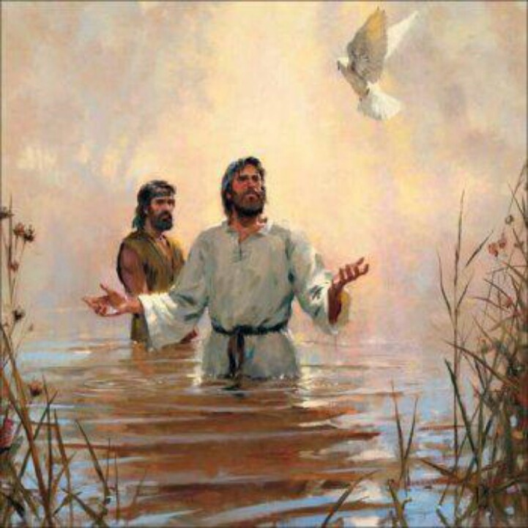
Scripture: Mark 1:9-11

Slide 11
Blessing

Slide 12
baptism
For Jesus
It marked him as Messiah
It started his journey
It was his “go” button
For us
We’re washed, moved, shaped, empowered, and nourished
It’s our “go” button

Slide 13
Our Prayer
Lord,
Thank you for the gift of baptism. You know what is good for me and what is good for the world. Help me to trust you.
Help me to remember that when I was baptized it began a relationship with you that I can trust in.
Amen.

