Slide 2
Connect with Your Small Group
Blessings and Bummers
Notes:
Have everyone check in with a blessing and bummer in their life.

Slide 3
What do you do when you’re in a difficult situation?
Complain
Pray
Ask someone for help
Face the challenge
Cry
Ignore the problem

Slide 5
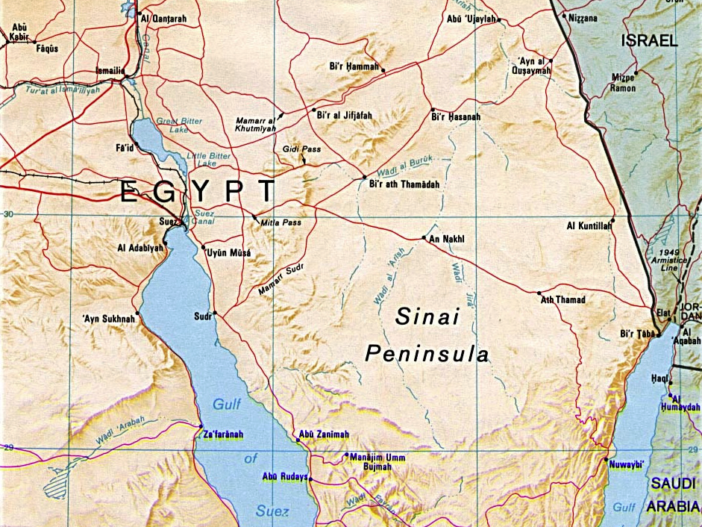
Notes:
Here is a map of Egypt and Israel. Next we will see the route they traveled to get back to Israel after escaping Egypt.

Slide 6
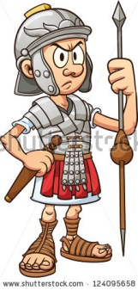
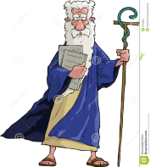
Notes:
We can see where Moses and the Israelites traveled and Pharaoh and his soldiers followed.

Slide 7
Notes:
We see here where Moses parted the red sea. Moses and the Israelites crossed. Pharaoh and his soldiers were swallowed up by the sea.

Slide 8
Exodus 14:21-30
²¹ Then Moses raised his hand over the sea, and the Lord opened up a path through the water with a strong east wind. The wind blew all that night, turning the seabed into dry land. ²² So the people of Israel walked through the middle of the sea on dry ground, with walls of water on each side!
²³ Then the Egyptians—all of Pharaoh’s horses, chariots, and charioteers—chased them into the middle of the sea.²⁴ But just before dawn the Lord looked down on the Egyptian army from the pillar of fire and cloud, and he threw their forces into total confusion. ²⁵ He twisted^{[a]} their chariot wheels, making their chariots difficult to drive. “Let’s get out of here—away from these Israelites!” the Egyptians shouted. “The Lord is fighting for them against Egypt!”
Notes:
Please read through Exodus

Slide 9
Exodus 14:21-30
²⁶ When all the Israelites had reached the other side, the Lord said to Moses, “Raise your hand over the sea again. Then the waters will rush back and cover the Egyptians and their chariots and charioteers.” ²⁷ So as the sun began to rise, Moses raised his hand over the sea, and the water rushed back into its usual place. The Egyptians tried to escape, but the Lord swept them into the sea. ²⁸ Then the waters returned and covered all the chariots and charioteers—the entire army of Pharaoh. Of all the Egyptians who had chased the Israelites into the sea, not a single one survived.
²⁹ But the people of Israel had walked through the middle of the sea on dry ground, as the water stood up like a wall on both sides. ³⁰ That is how the Lord rescued Israel from the hand of the Egyptians that day. And the Israelites saw the bodies of the Egyptians washed up on the seashore.

Slide 10
When bad things happens to you, is it alright be mad at God?
Notes:
Ask the kids what they think.

Slide 11
Yes – as long as it’s temporary
We shouldn’t hold grudges against God
We have to remember all the blessings we’ve received from God and how much he has done for us already!
It’s easy to focus on the bad stuff and forget about the good parts of our lives or the good things God has done for us.

Slide 13
God calls us to have faith!
Notes:
Sometimes it can be hard to have faith because life is scary. Always know that God is by your side and loves you. Faith in God changes everything!

Slide 14
Our Prayer
Through the trials and storms, help me hold on to my faith. Stay with me Lord, and show me Your way. Amen.

Slide 15
Blessing
The Lord bless you and keep you; the Lord make his face shine on you and be gracious to you; the Lord look upon you and give you peace.

