Slide 2
Welcome Back!

Slide 3
Let’s Pray.

Slide 4
Would you?!?
Stand if you would…
or
Staying seated if you wouldn’t…

Slide 5
Would you?!?
Invite your least favorite person in the world to come to church with you.
Leave your home and change EVERYTHING you’ve known to be a disciple of Jesus.
Share everything you had with others, even if it meant giving away most of your stuff.

Slide 6
Why or why not?

Slide 8
Story of Saul: Acts 9: 1-6
Saul was a wicked man who did evil things to Christians.
God blinded him to prove his power.
But, why is Saul important?

Slide 9
Why would God pick Saul?
Why do you think God chose to pick Saul to preach and teach God’s word?

Slide 10
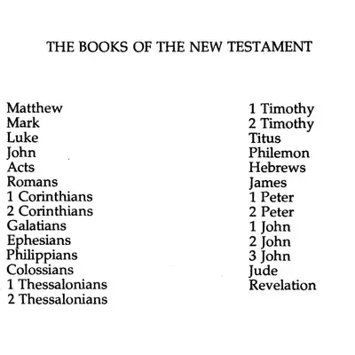

Slide 11
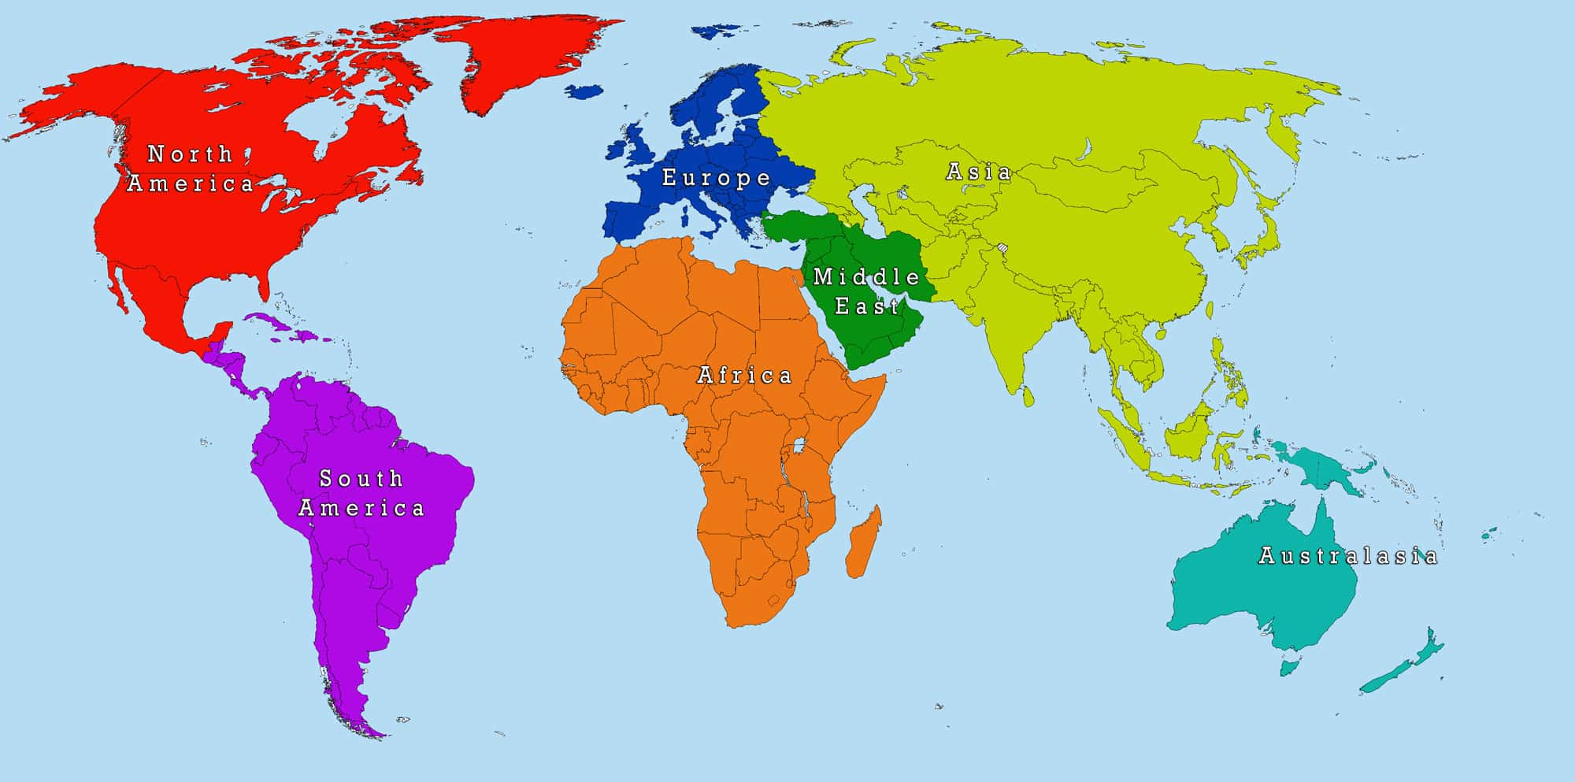

Slide 12
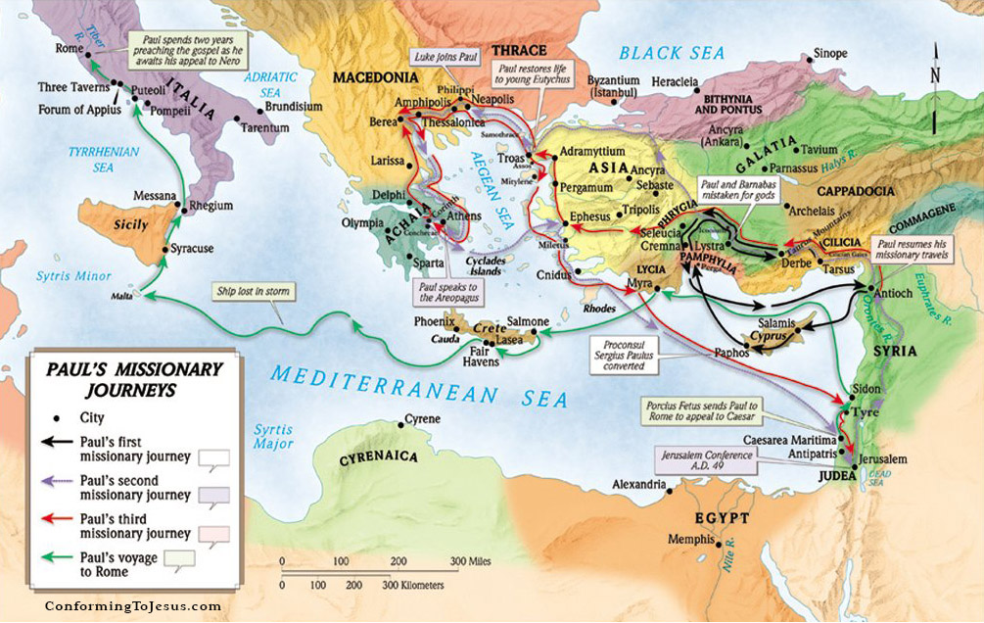
Paul: the 1st Missionary

Slide 15
Transformation
What’s transformation?
Can you give me examples?
What are some good things about transformation and bad things about transformation?

Slide 16
Transformation
Caterpillar into a butterfly.
Pros: Able to fly, brightly colored, can move easier, etc.
Cons: Not able to hide as easily, growing older, can’t easily walk around on things, etc.

Slide 17
Pros and Cons of Transformation
Transformation is not always an easy process.
There are benefits and drawbacks of transforming.
When we transform, we might lose things like friends or respect.

Slide 18
God’s Transformation
God calls us to transform because it’s better for us.
He calls us to transform into better people, into followers of Christ, into true believers who do the best work in this world – God’s work!

Slide 19
What do you need to change?
Do you have bad habits in your life?
Do you do things that you know you shouldn’t?
What things do you need to examine your life so that you can be more in line with God’s wishes for you?

Slide 20
Our Prayer
Dear God,
We trust you, knowing that you will change and transform us if we let you. We know that you want to transform us into followers of Christ, to do your work. Let us not be scared, but excited, about our future in you. In your name we pray. Amen.

