Slide 2
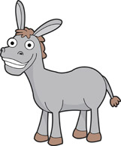
Week 1: Judges
Ehud: the left handed
Deborah: a woman
Jephthah: Son of a prostitute, chased off the land and out of his family.
Abdon: had 40 sons and 30 grandsons who rode 70 donkeys
Samson: not a good guy to be around

Slide 3
Judges → Kings
Read in the Bible 1 Samuel 8:1-9
Who’s on the throne?

Slide 4
Kings of God’s People
Saul
David
Solomon
Israel splits into two

Slide 6
King David
Youngest and smallest of 7 sons
Israel’s most important King
David was righteous- meaning God was always first for him

Slide 7
Take Aways
“Don’t judge by appearance or height! …The Lord doesn’t see things the way you see them… the Lord looks at the heart.” 1 Sam 16:7
Though the Israelite’s went against God in desiring a King, God still used the Kings to lead his people.

Slide 8
Our Prayer
Dear God-
Help us to be righteous like David, always putting you first.
Amen.

