Slide 2
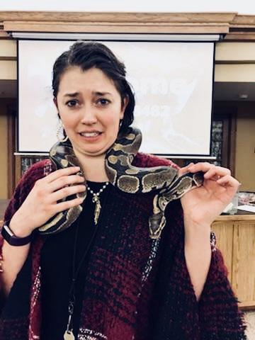
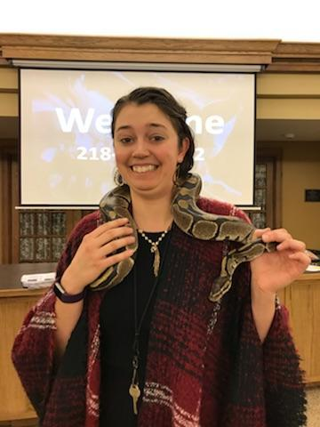
Come to Luther Crest!

Slide 3
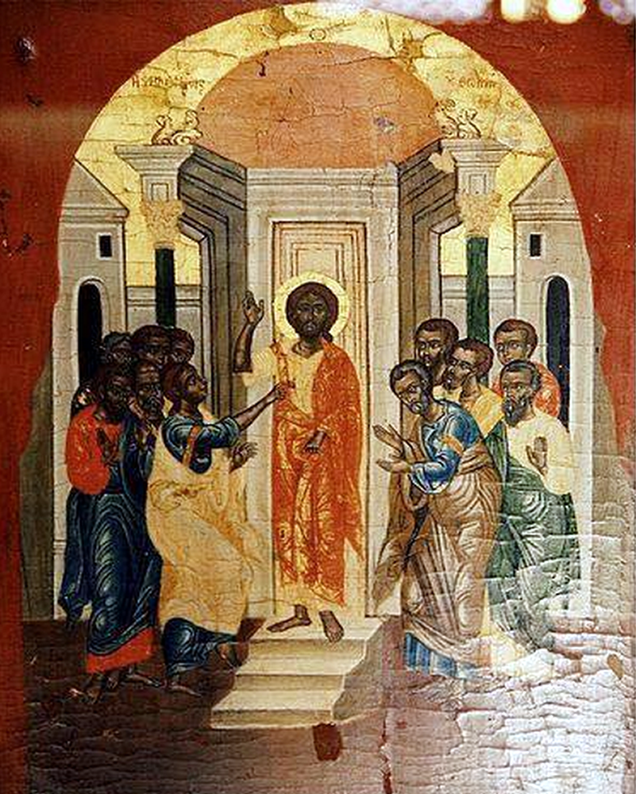
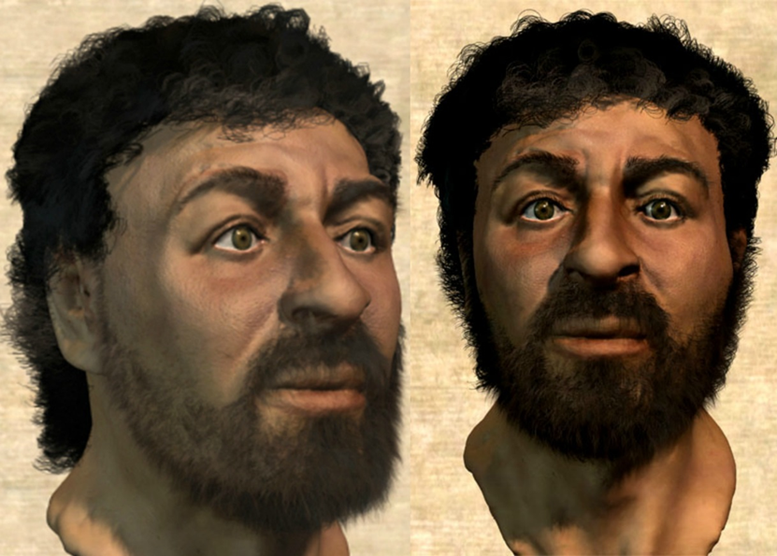
Jesus Christ
Who was he?

Slide 4
Jesus was known for:
His 12 Disciples
Teaching
Telling stories (parables)
Doing miracles
Having compassion
Being the Son of God
Dying
Not staying dead!
Changing all the rules

Slide 5
Jesus’ Week in Jerusalem
While Jesus eats with Simon the Leper – religious leaders plot a way to kill Jesus
Jesus condemns the temple after driving out people treating it as a market place
Jesus ride into Jerusalem welcomed like a King
Passover meal is consumed
Jesus teaches in the temples
Passover feast is prepared
Jesus is put on trial
Jesus is crucified
Jesus is arrested
Sun.
Mon.
Tues.
Wed.
Thur.
Fri.|12AM
Fri.|3AM
Fri.|9AM
Palm Sunday
Good Friday

Slide 6
Passover
Jesus: the Son of God

Slide 7
Old Testament History Lesson
Israelites were slaves under Egyptian control
God sent Moses to Pharaoh to let the Israelites go
Pharaoh said no – God and Moses sent a plague
After each plague, Moses gave Pharaoh a chance to free the Israelites, each time Pharaoh said he would – Moses stops the plague – Pharaoh changed his mind
God sent 10 plagues before Pharaoh would let the people go

Slide 8
Plagues
Water into blood
Frogs
Lice
Flies
Disease killed livestock
Boils
Thunderstorms with hail and fire
Locusts
Darkness
Death of firstborn child

Slide 9
Video Clip
https://www.youtube.com/watch?v=-KUuoayD7G4

Slide 10
Exodus 12:13
“The blood will be a sign for you
on the houses where you are,
and when I see the blood, I will pass over you. No destructive plague will touch you.”

Slide 11
Passover Feast
Done every year to remember that event in Egypt
Done to remember God’s power
Done to remember how God wanted to be with His people so much that God saved them from Egypt

Slide 12
Please open to Luke 22:14-20

Slide 14
Why the blood?
God wanted to be with His people and Pharaoh wouldn’t let Him. God had the lamb die so the Israelites would live.
Today, God still wants to be with us, but our sin doesn’t let Him. God is perfect, we are not.
Now, God needs a new lamb’s blood…

Slide 15
John 3: 16
“For God so loved the World that He gave his only Son. So that whoever believes in him would not perish but have eternal life.”

Slide 16
The Bubble Prayer
Whisper your prayers, thoughts, questions, joys, and concerns to God.

