Slide 2
Expectation vs Reality

Slide 3
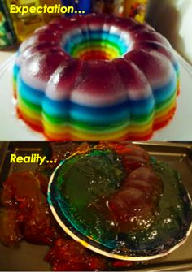
Expectation vs reality

Slide 4
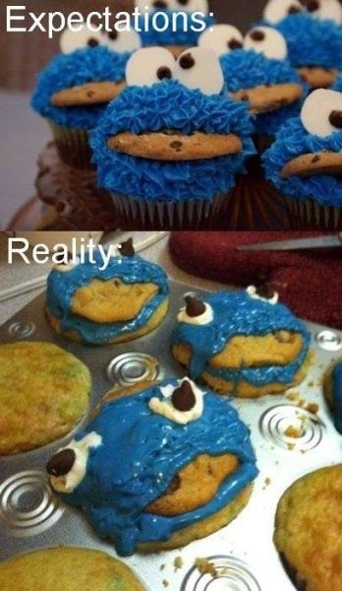
Expectation vs reality

Slide 5
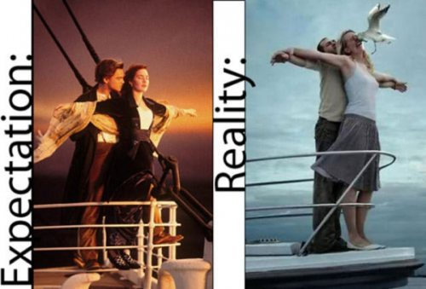
Expectation vs reality

Slide 6
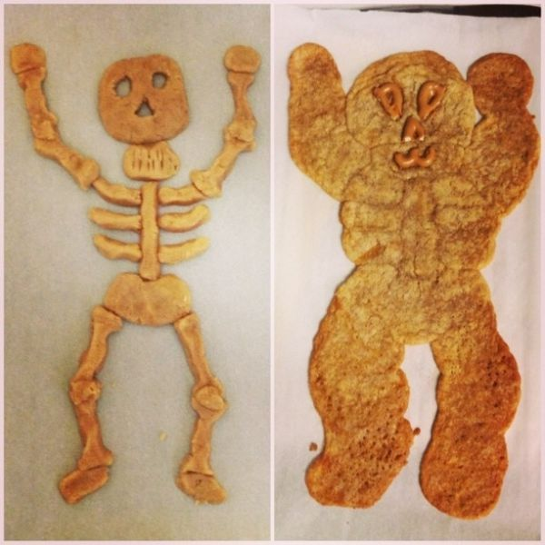
Expectation vs reality

Slide 7
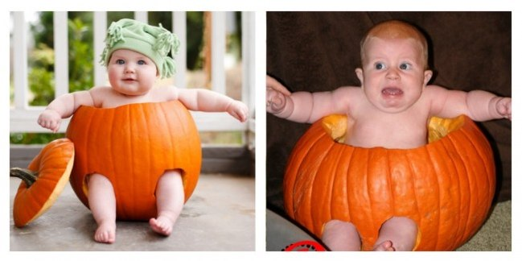
Expectation vs reality

Slide 8
Expectation vs reality

Slide 9
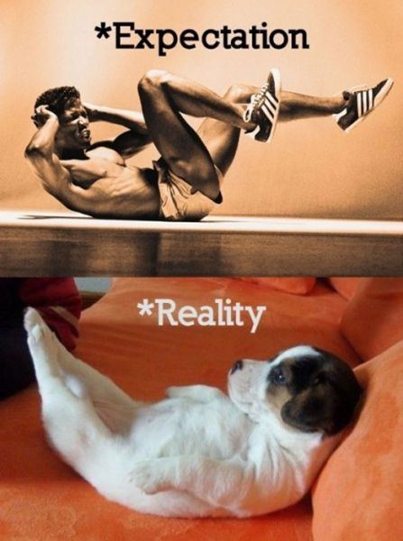
Expectation vs reality

Slide 10
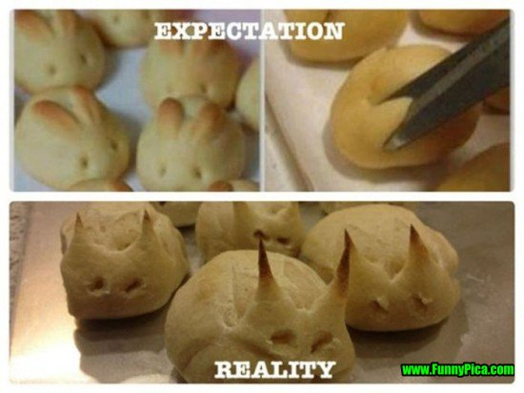
Expectation vs reality

Slide 11
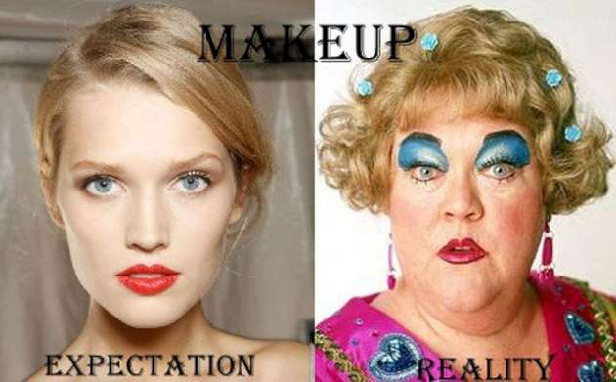
Expectation vs reality

Slide 12
Matthew 7:24-27
21 When they had come near Jerusalem and had reached Bethphage, at the Mount of Olives, Jesus sent two disciples, ² saying to them, “Go into the village ahead of you, and immediately you will find a donkey tied, and a colt with her; untie them and bring them to me. ³ If anyone says anything to you, just say this, ‘The Lord needs them.’ And he will send them immediately.^{[a]}” ⁴ This took place to fulfill what had been spoken through the prophet, saying,
⁵ “Tell the daughter of Zion, Look, your king is coming to you, humble, and mounted on a donkey, and on a colt, the foal of a donkey.”

Slide 13
Matthew 7:24-27
⁶ The disciples went and did as Jesus had directed them; ⁷ they brought the donkey and the colt, and put their cloaks on them, and he sat on them. ⁸ A very large crowd^{[b]} spread their cloaks on the road, and others cut branches from the trees and spread them on the road. ⁹ The crowds that went ahead of him and that followed were shouting,
“Hosanna to the Son of David! Blessed is the one who comes in the name of the Lord! Hosanna in the highest heaven!”
¹⁰ When he entered Jerusalem, the whole city was in turmoil, asking, “Who is this?” ¹¹ The crowds were saying, “This is the prophet Jesus from Nazareth in Galilee.”

Slide 14
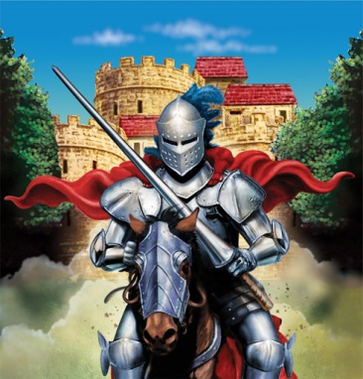
Jesus
Expectation vs Reality
Warrior/King/Ruler to over throw Rome and free the oppressed.
They shouted Hosanna – meaning save or help knowing that a King has the power to do that.
Greeted him with palm leaves – symbolic of a victorious ruler.

Slide 15
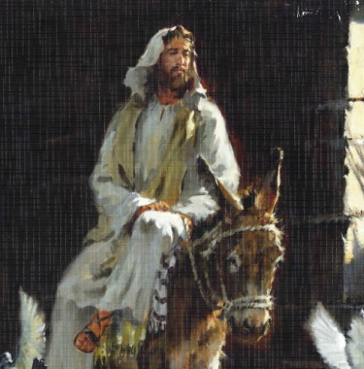
Jesus
Expectation vs Reality
Man bringing a message of change and transformation.
Had no power within the government, had no army to challenge the Romans.
His goal was to sacrifice his life for all the people – giving them eternal life. His main focus was on the next life not their present situations.

Slide 17
Jesus’ Week in Jerusalem
When Jesus came into Jerusalem to celebrate the Passover festival he was treated and welcomed like royalty.
Within a week the same people who graciously adored and welcomed him screamed “Crucify him!” at his trial.
Why do you think they all change their minds?

Slide 18
Jesus’ Week in Jerusalem
While Jesus eats with Simon the Leper – religious leaders plot a way to kill Jesus
Jesus condemns the temple after driving out people treating it as a market place
Jesus ride into Jerusalem welcomed like a King
Passover meal is consumed
Jesus teaches in the temples
Passover feast is prepared
Jesus is put on trial
Jesus is arrested
Jesus is crucified
Sun.
Mon.
Tues.
Wed.
Thur.
Fri.|12AM
Fri.|3AM
Fri.|9AM

Slide 19
Jesus’ Week in Jerusalem
Was there ever a time that our expectations did not match our reality?
When that happens– how do we feel?
If you were in Jesus’ shoes how would you feel towards the people in Jerusalem?
How did Jesus respond?

Slide 20
Connect with Your Small Group
Blessings and Bummers
Bibles – Matthew 21:1-11

Slide 21
Connect with Jesus (2Q’s)

Slide 22
Our reality
Jesus told us to believe in him and we’d be saved. God sent us a King. God told us not to eat from the apple tree. God asked us to love our neighbors. God asks us to forgive our enemies.
He never said it would be easy.
We didn’t think he meant a baby.
He didn’t say it would be so tempting.
He didn’t mention how annoying they’d be.
He didn’t tell us they’d hurt us so much.

Slide 23
Our Prayer
God, today we pray with confidence in you. We pray for the strength to keep our eyes open for your answers. Work to strengthen our understanding, strengthen our faith, and strengthen our hope in you.
Amen.

Slide 24
Blessing
The Lord bless you and keep you; the Lord make his face shine on you and be gracious to you; the Lord look upon you and give you peace.

