Slide 2
God’s Big Story
Ascension and Pentecost

Slide 3
Let’s Pray
(3 deep breaths) God, you are above (reach toward the sky),
below (touch your toes),
inside (hands to heart),
and all around (big arm circles).

Slide 4
I worship you (reach toward the sky),
and give my life to you (touch your toes). And I love you (hands to heart)
with all that I am (big arm circles). (3 deep breaths)
Amen.

Slide 5
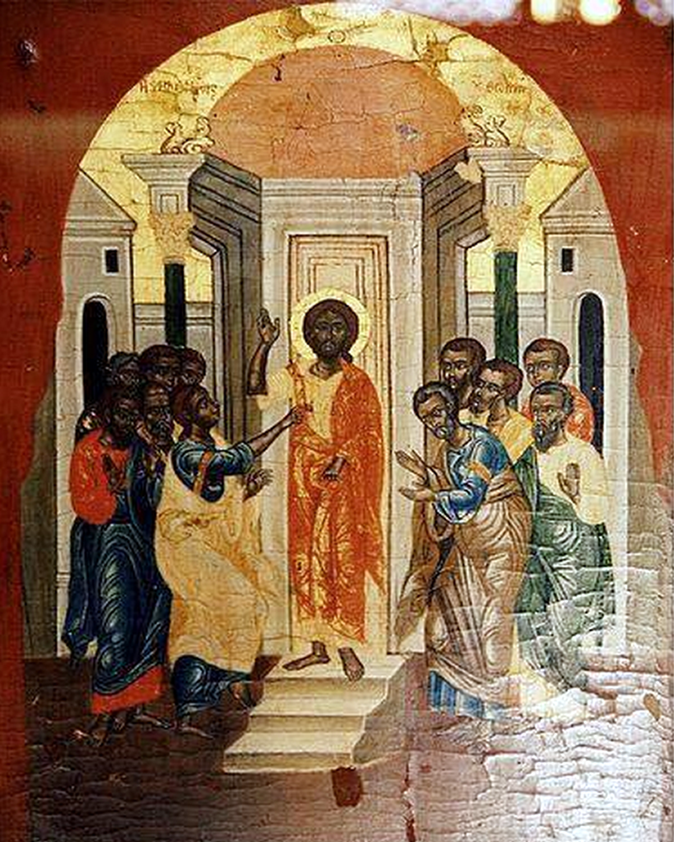
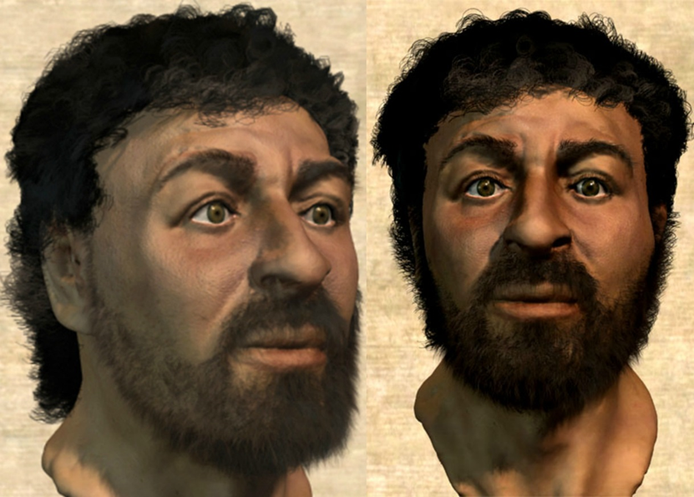
Jesus Christ
Who was he?

Slide 6
Jesus was known for:
His 12 Disciples
Teaching
Telling stories (parables)
Doing miracles
Having compassion
Being the Son of God
Dying
Not staying dead!
Changing all the rules
Jesus leaves and promises to come again

Slide 7
Grab a Bible, Find the Table of Contents

Slide 8
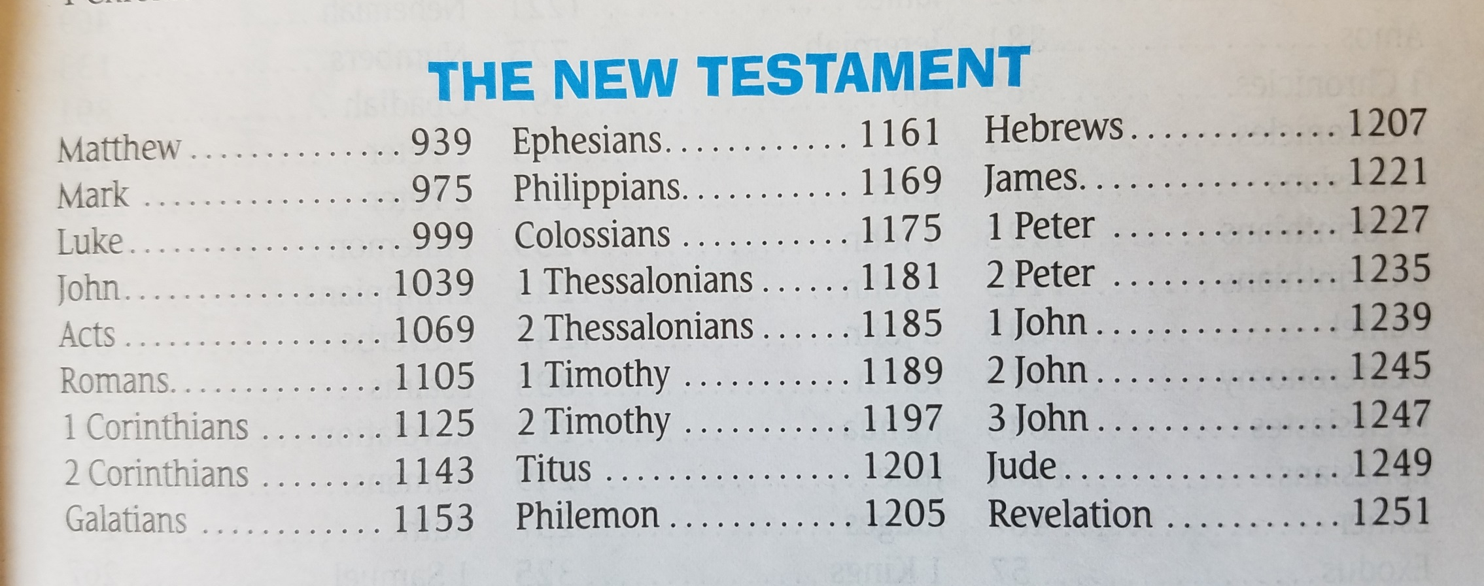

Slide 9
Describe Jesus’ Life
Paul Wrote

Slide 10
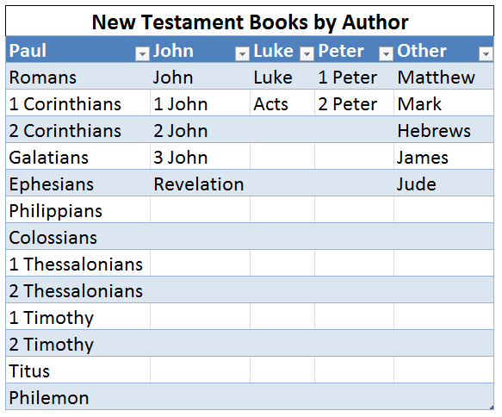

Slide 11
Open your Bibles:
Luke 24: 35-43, 50-52
Recap- Acts 1:9-11
Acts 2:1-8

Slide 12
Add video!!

Slide 13
A New Start
The ascension was not the end of Jesus’ ministry….
It marks the beginning of the church!
But, who are we supposed to tell?

Slide 14
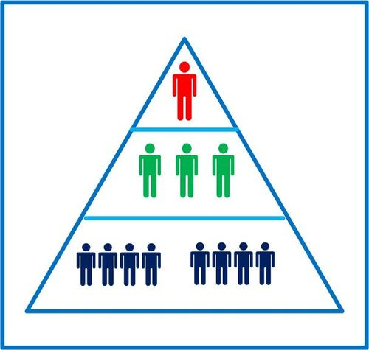
Jesus
Disciples
Everybody Else

Slide 15
Jesus
Everybody Else
We are all Disciples

Slide 16
The Lord’s Prayer
Our Father, who art in heaven
Hallowed be thy name
Thy kingdom come, thy will be done
On earth as it is in heaven
Give us this day our daily bread

Slide 17
And forgive us our trespasses as we forgive those who trespass against us.
And lead us not into temptation
But deliver us from evil.
For thine is the kingdom, the power, and the glory
Forever and ever. Amen

